Slide 1

EXERCISE Brunswick Charlie 2020

Slide 2

Exercise Brunswick Charlie 2020 Logo

Slide 3
Aim
A province wide exercise designed to allow those responsible for, and involved with, Emergency Management an opportunity to practice planned responses and other procedures. This exercise like previous ones, will afford participants the opportunity, to challenge their Emergency Management and response components.
Using a new but realistic scenario, and databank of prepared injects to assist communities & add realism.
Notes:
The aim of these provincial exercises is to provide all involved an opportunity or a “platform if you will” to practice Emergency responses that could potentially affect your communities or departments. Allow participants the ability to practice procedures as they relate to planning, mitigation, response and recovery. Additionally it is an occasion to develop contacts and build relationships that are the foundation of successful Emergency response.

Slide 4
Scope
The scope of the exercise, developed provincially, is designed to encourage maximum participation from all municipalities , LSD’s, SAR partners and First Nation Communities within the province, regardless of their level of preparedness.
All communities & emergency management partners are encouraged to participate.
This exercise will present a new scenario that will allow participants the flexibility to prepare for impacts that could affect their citizens.
The Provincial Emergency Operations Centre along with the Regional Emergency Operation Centres will be activated for this exercise.
Notes:
Communities can participate at what ever level they desire, from the basics such as activation and communication to more in depth level for those that have more resources and want a higher level of participation

Slide 5
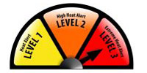
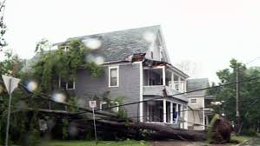
Scenario
A severe heat wave immediately followed by a short duration tropical storm will allow participants a broad scope of potential impacts. (Power outages, health emergencies, evacuations, comms interruptions, industrial accidents, fires, localized flooding, vandalism, lost persons etc…)
Simulated social media, and web based news reporting will add to the realism of the exercise.
Notes:
As you are all well aware it is difficult to come up with an effective scenario that is realistic but has enough flexibility, to allow participants to practice the aspects that they need and want. This year we have decided that a severe heat wave followed by a short duration tropical storm would provide that opportunity.

Slide 6
Reasons to Conduct an Exercise
To practice and evaluate plans, policies and procedures
Identify plan vulnerabilities and gaps in resources
Improve organizational coordination and communications
Clarify roles and responsibilities
Improve individual and team performance
Satisfy regulatory requirements
Notes:
These are some reasons, I am sure that upon completion of the exercise you will be able to look back and provide many more.

Slide 7
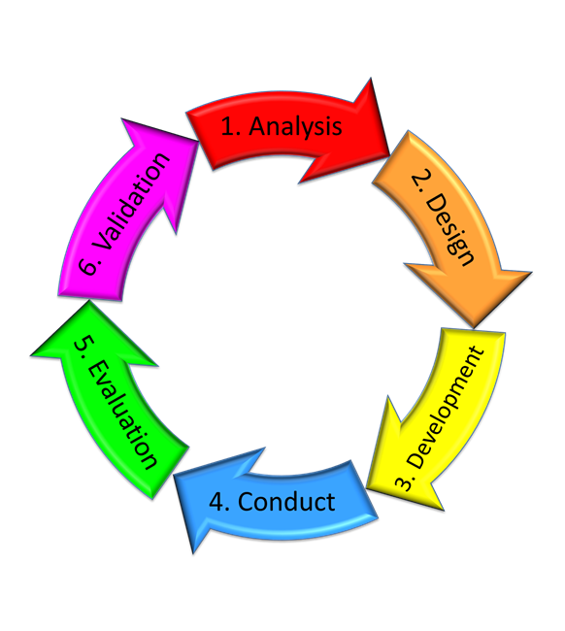
Exercise Design
Notes:
When designing an exercise it is important to follow the six steps.

Slide 8
Exercise Design
Six stage exercise design cycle which includes:
Analysis. Organizations training plan/training cycle includes an exercise cycle. An authority determines it is time to conduct an exercise. The Concept Development Conference (CDC) is held to commence planning. Review of previous training events.
Design. Begins as soon as the CDC is starts. Some points to consider include: determining the specific need to exercise, identifying all available resources, gaining senior management support, and developing a draft timeline.
Development. The bulk of the exercise details will be planned (IPC, MPC, WB, FPC, & through coordination).
Conduct. The conduct of the exercise (TTX, CPX, FTX).
Evaluation. The analysis of the planning, conduct and execution of the participants and planning staff followed by the comparison of their performance against the expected standard (HOTWASH).
Follow up (Validation). Through the use of an AAR/PXR, addressing the need to create and implement an action plan in order to address all areas requiring improvement from the participants and planning staff.

Slide 9
Exercise Design Cont’d
Primary Target Audience for Ex is Municipalities/ LSDs/First Nations communities and their pers
Secondary TA Is organisations within the communities such, fire, police, GSAR etc..
Many other organisations benefit as well PEOC, REOC, Red cross etc…
Exercise Control
Secondary Training Audience
Primary Training Audience
Notes:
When designing an exercise is important to determine who the exercise is to benefit. This particular exercise is designed to allow the Primary Target Audience, the municipalities, LSDs, first nation communities and personal designated to manage emergency response with in them.
This affords exercise designers and communities the opportunity to pass along the benefits derived from an exercise to other agencies such as police, fire, GSAR, EMT, health, industry and others. These are known as secondary target Audience

Slide 10
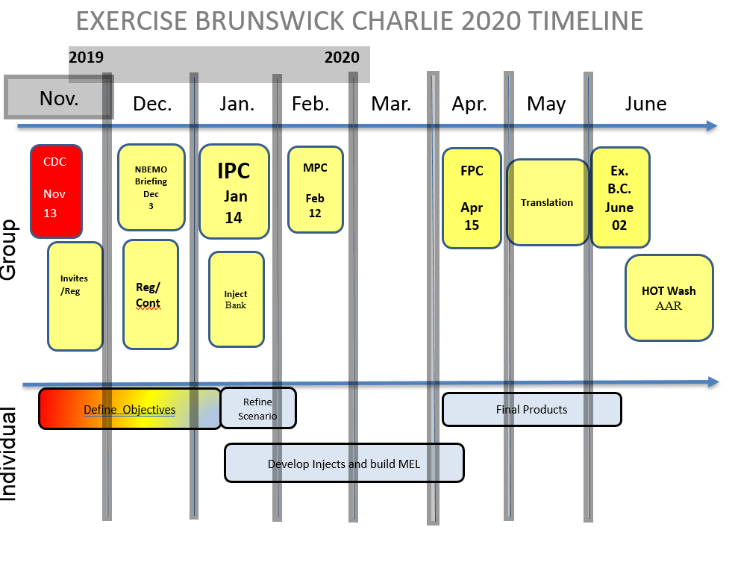

Slide 11
Brunswick Charlie 2020 Website
NBEMO has created a website that provides access and updates on the exercise.
This site provides the latest progress on the exercise design and conduct, and links to other pertinent information and feeds.
List of participants
The site can be accessed by going to: www.gnb.ca/brunswickex
Notes:
The province has made a website that is updated regularly, anyone wishing to obtain a copy of the Power points will be able to find them there.

Slide 12
Participants
There will be a number of participants including:
The New Brunswick Emergency Measures Organization
Provincial/Regional Emergency Action Committees
The Canadian Armed Forces, through Joint Task Force Atlantic
Environment and Climate Change Canada
Regional Emergency Management Coordinators
Participating New Brunswick communities
GNB partners and organizations to be identified
Notes:
Other includes any Org or department that may wish to participate.

Slide 13
Trusted Agents
The exercise design will include what is known as “Trusted Agents” (TA) who are not exercise players
TA’s are exercise controllers that represent participants during the design of the exercise.
TA’s are responsible for providing injects or exercise activities for the exercise players they represent.
Notes:
For those that may not be aware these provincial exercises have what is known as trusted agents. Theses designated personal will represent the their communities and organisations during the design and development of the exercise.
Trusted Agents are responsible for helping determine what particular procedure or aspects their community or organisation need to practice. From there the TA with our help can develop injects or exercise activities for the exercise players.
The design team has developed a list of possible injects to aid trusted agents in coming up with some possible injects that will be found on the exercise web site.

Slide 14
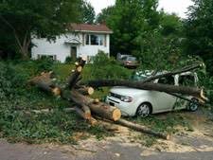
Exercise Objectives
NBEMO Objectives remain the same as previous exercises:
Activation of Municipal / local EOC’s
Exercise local emergency response plans
Communications at all levels
Reporting requirements
Create discussion on State of Local Emergency/State of Emergency
Create discussion on Request for
Assistance & Provision of Services (CAF)
Provide SAR partners an opportunity to participate
Local Objectives
To be established at the local level
Notes:
Local objectives can be pretty much anything you would to achieve!
Small communities might just want to exercise activation and communications.
Others may want to test plans, or practice procedures such as, evacuation of a nursing or special care home, setting up of a reception centre, responding to a problem at a larger community complex.
Still other communities or Organisations that have more resources may want to exercise more complicated scenarios such a downed plane, severe fires, mass casualties etc…

Slide 15
Key Dates
Initial Planning Conference (IPC) – 14 Jan. 0900-1500hrs
Main Planning Conference (MPC) – 12 Feb. 0900-1500hrs
Final Planning Conference (FPC) – 15 April. 0900-1500hrs
Exercise Brunswick Charlie - 02 Jun. 0900-2000hrs throughout the province
Notes:
All planning conferences will be WebEx based but all are encouraged to attend in person.

Slide 16
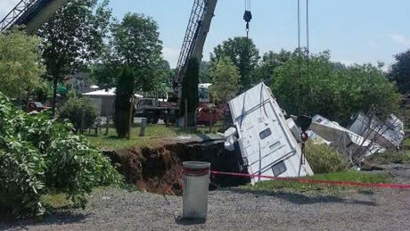
After Action Review
All participants are encouraged to self-evaluate.
Best practices and important lessons learned should be shared – NBEMO will compile points.
NBEMO AAR template will be located on the Ex webpage
Notes:
We will walk before we run and therefore will be no formal evaluation. NBEMO working group will produce a form for the participants to provide feedback on the overall exercise.

Slide 17
Why should you participate?
This is an excellent opportunity:
For those responsible for Emergency Management to be involved in a provincial level exercise that will be uniquely focused on individual communities needs.
To share best practices between communities.

Slide 18
How do you sign up?
Obtain authorization to participate at the local level
Designate a Trusted Agent who can represent your community and develop injects to meet your objectives, work with your REMC to ensure your goals are met.
Complete the questionnaire and confirmation of participation & send it to brunswickex@gnb.ca

Slide 19
QUESTIONS ?

Slide 20
Exercise Calendar
14 Jan – IPC
21 Jan - Inject bank posted on website
29 Jan- working group with key pers
12 Feb – MPC
11 Mar- Working group with key pers
15 April –FPC
15 May- translation complete
22 May – Player guides/ EXCON manual and MEL distributed.
26/27May -Warm start
28/29 May – test social media access (warm start continues)
30/31 May (warm start cont)
01 June – Short duration tropical storm breaks heat wave
02 June Exercise Brunswick Charlie (Hot wash)
10 June- Hotwash points returned to NBEMO

