Slide 1
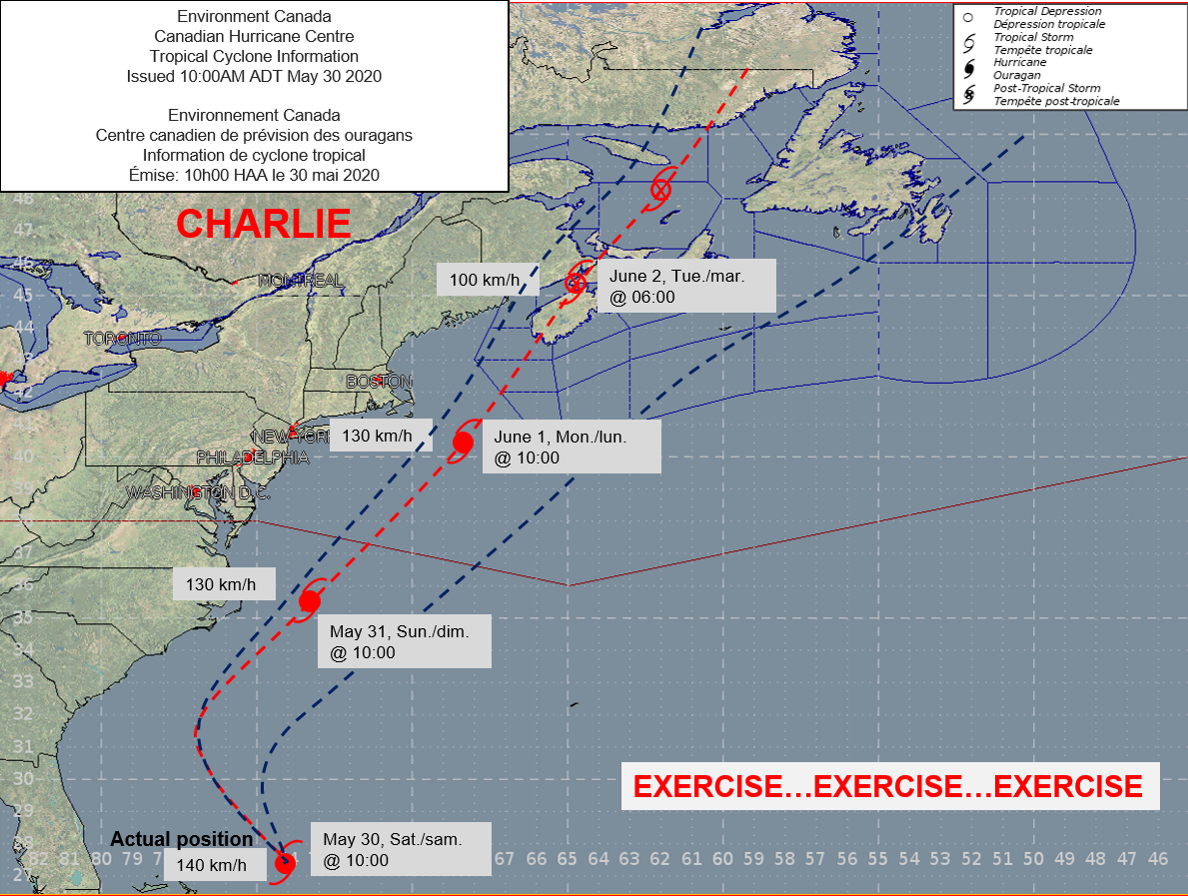


Initial Planning Conference
January 14, 2020
EXERCISE BRUNSWICK CHARLIE

Slide 2
Exercise Brunswick Charlie 2020
Who we are (our structure)
What we do (our forecasts)
How you can access the information
Tropical cyclone and Heat information (basic)
Weather timeline for Exercise Brunswick Charlie 2020
Page 2 – October 31, 2019

Slide 3

Environment and Climate
Change Canada
Meteorological Service of Canada
Regions are:
Atlantic
Quebec
Ontario
Prairie and Northern
Pacific and Yukon
Our mandate:
  Environment and Climate Change Canada provides weather forecasts and alerts 24 hours a day, seven days a week, to help protect the safety and security of Canadians and their property.
Page 2 – October 31, 2019

Slide 4
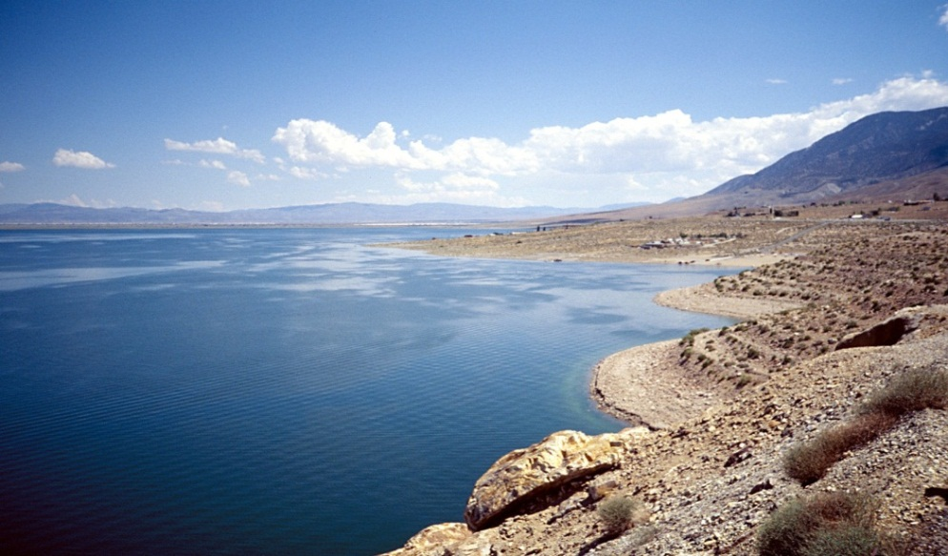
Meteorological Service of Canada
The service monitors the following conditions:
Weather
Air Quality
Climate
Climate Change
El Nino/La Nina
Ice information
Ozone Layer
Ultra Violet Radiation (UV)
Water Quantity
Page 2 – October 31, 2019

Slide 5

Meteorological Service of Canada
Agencies that provide official weather information for New Brunswick:
Atlantic Storm Prediction Centre (ASPC) – Dartmouth, NS
Forecasts, graphical products and public alerts
Canadian Hurricane Centre (CHC) – Dartmouth, NS
Tropical cyclone forecasts, alerts, and information
Accessing weather information for New Brunswick:
Warning Preparedness Meteorologist (WPM) – Fredericton, NB
Liaise and communicate significant events with provincial officials and agencies
Websites (weather.gc.ca, hurricanes.ca, twitter, etc.)
WeatherCAN app
Page 2 – October 31, 2019

Slide 6
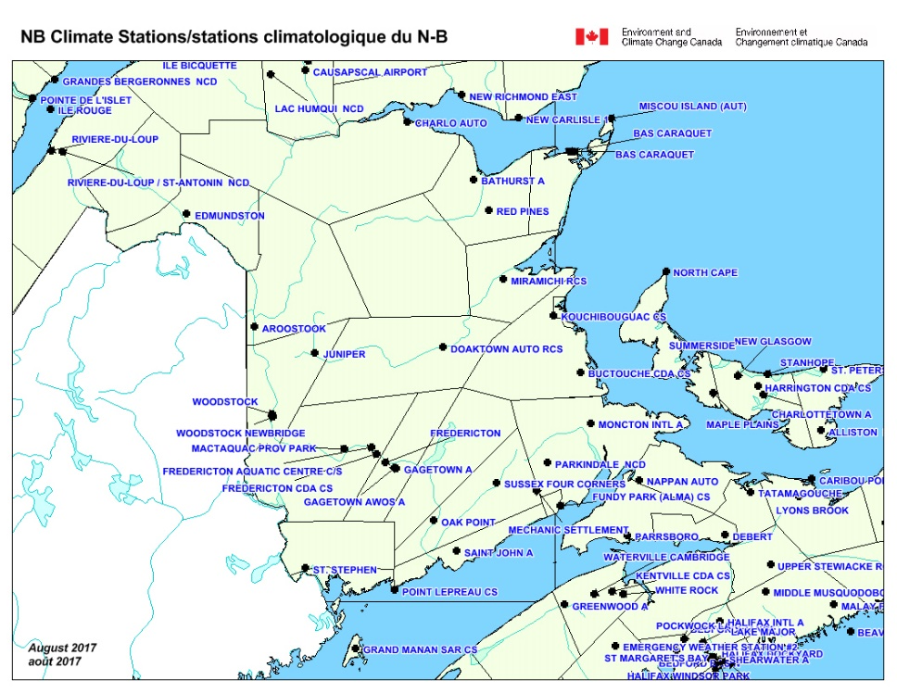
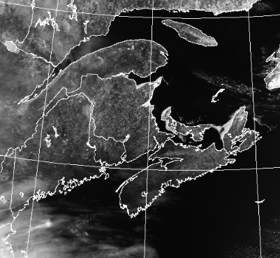

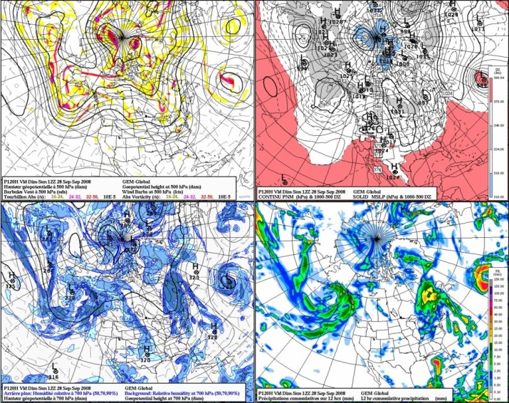
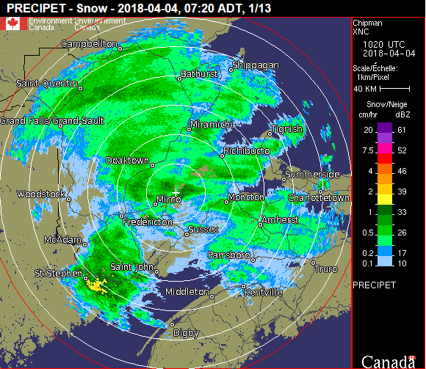
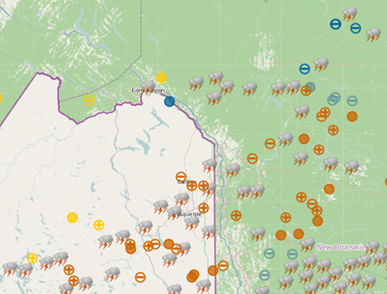
Weather Forecasts/Alerts from A to Z
Satellite imagery
Supplementary
observations
Computer modelling
Weather radar
Lightning detection
Page 2 – October 31, 2019

Slide 7

Public Weather Alerts
Winter
  Blizzard
  Blowing snow
  Freezing drizzle
  Freezing rain
  Rainfall
  Snow squall
  Snowfall
  Wind chill
  Winter storm
Summer
  Rainfall
  Severe thunderstorm
  Tornado
  Frost
  Heat (Humidex and Health)
  Hurricane/Tropical Cyclone
  Air Quality
Winter
Summer
Types of public alerts:
1. Special Weather Statement
2. Advisory
3. Watch
4. Warning
Storm surge, Fog and
Wind alerts year round
Page 2 – October 31, 2019

Slide 8
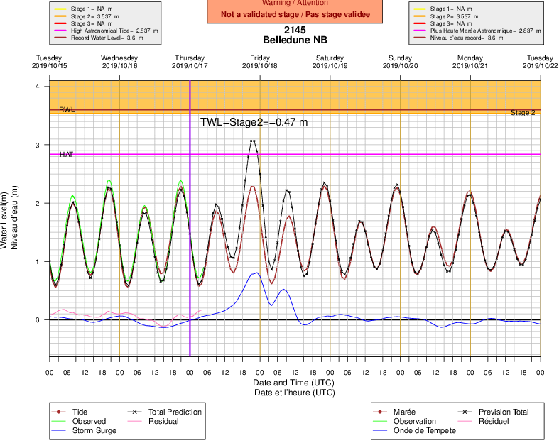
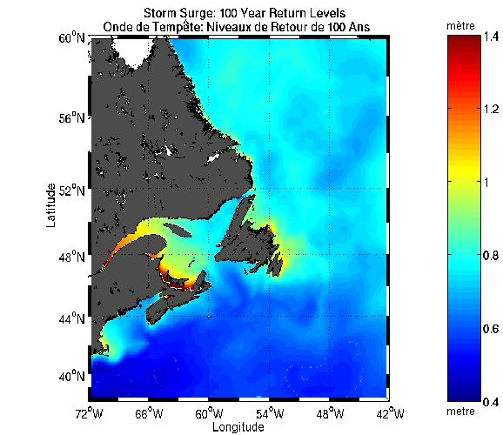
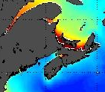
Storm Surge; Time Series and maps
Generally, coastal eastern communities are more susceptible to storm surge
Page 2 – October 31, 2019

Slide 9
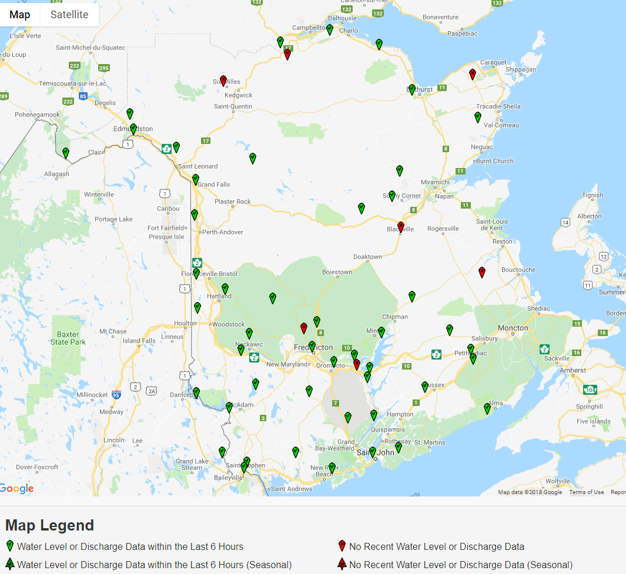
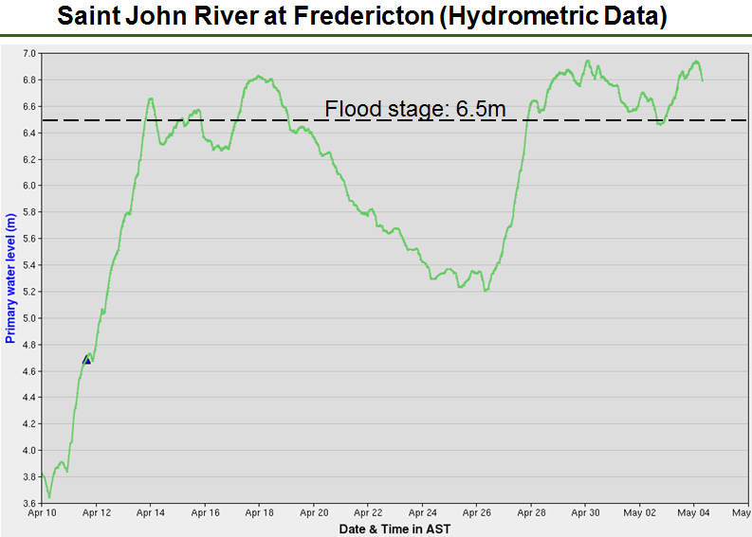

Maritimes Hydrometric Stations
Page 2 – October 31, 2019

Slide 10
Weather in Emergency Management
Mitigation
Weather and your emergency plan
Understanding the Hazards: Storms and associated impacts
Basic weather information for emergency managers
Post impact weather intelligence
Emergency
Management
Recovery
Preparedness
Weather considerations during floods
Weather considerations during tropical storm, freshet, forest fire, etc… season
Weather considerations during ice storms
Weather considerations during significant weather events
Weather considerations during summer severe weather events.
Response

Slide 11
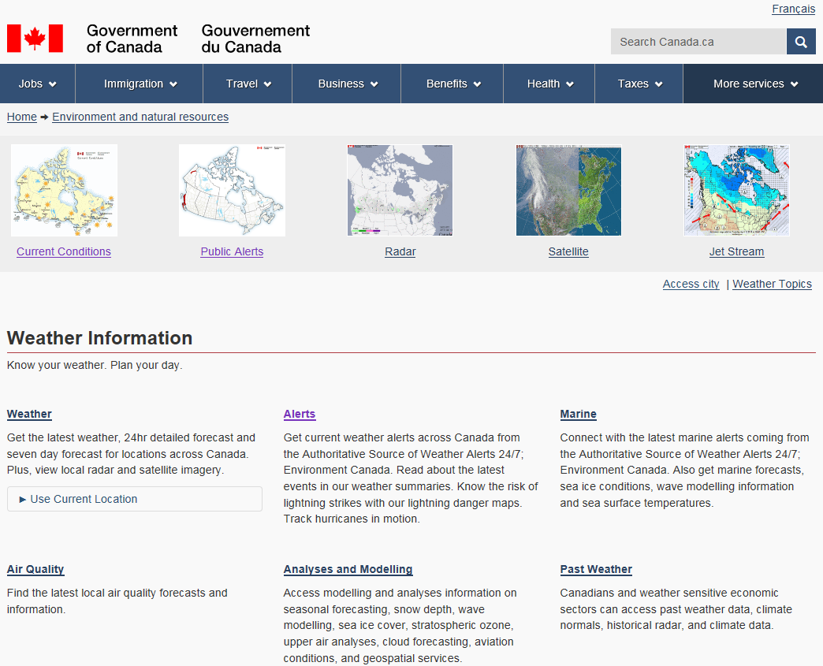
www.weather.gc.ca (1)
Page 2 – October 31, 2019

Slide 12
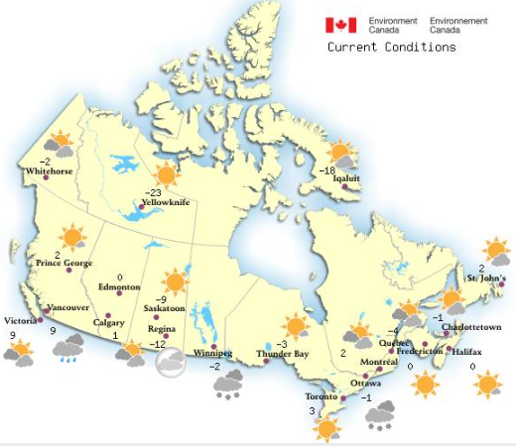
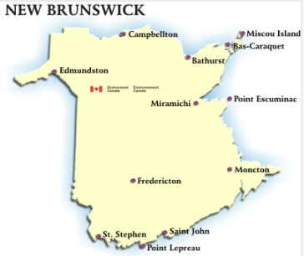
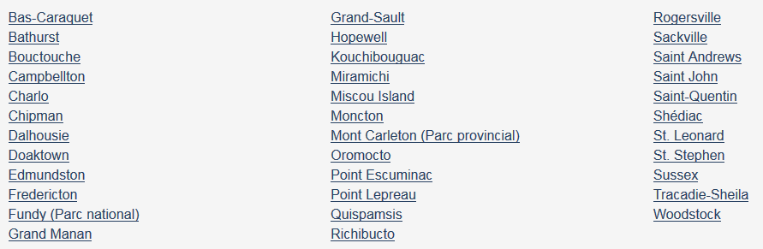
www.weather.gc.ca (2)
Page 2 – October 31, 2019

Slide 13
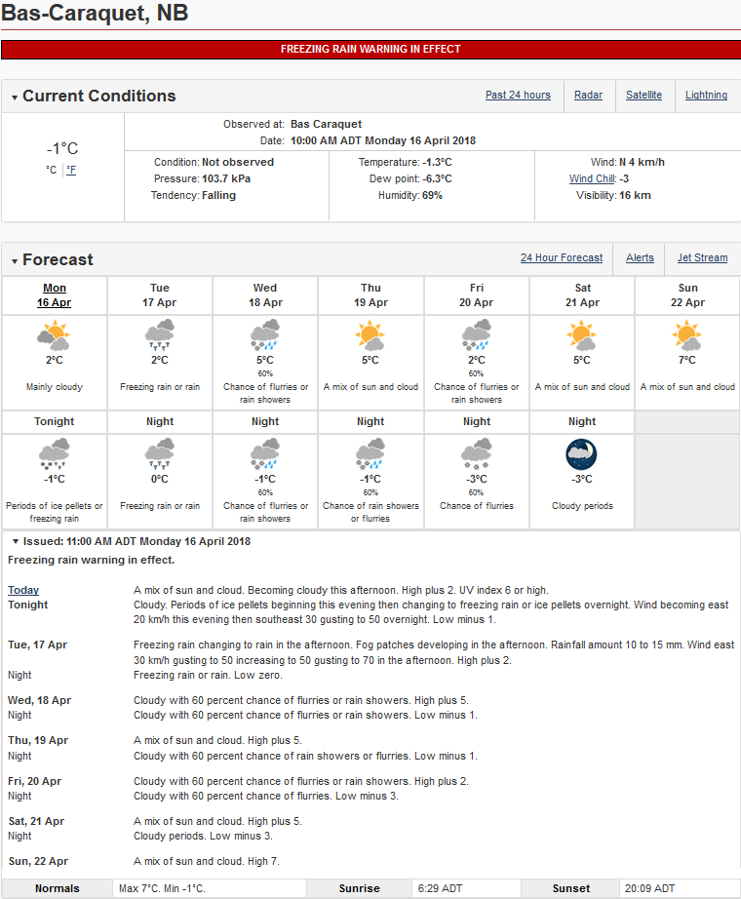
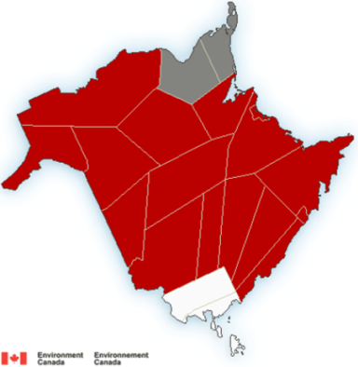
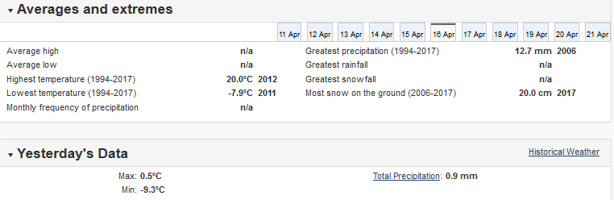
www.weather.gc.ca
(3)
Page 2 – October 31, 2019

Slide 14
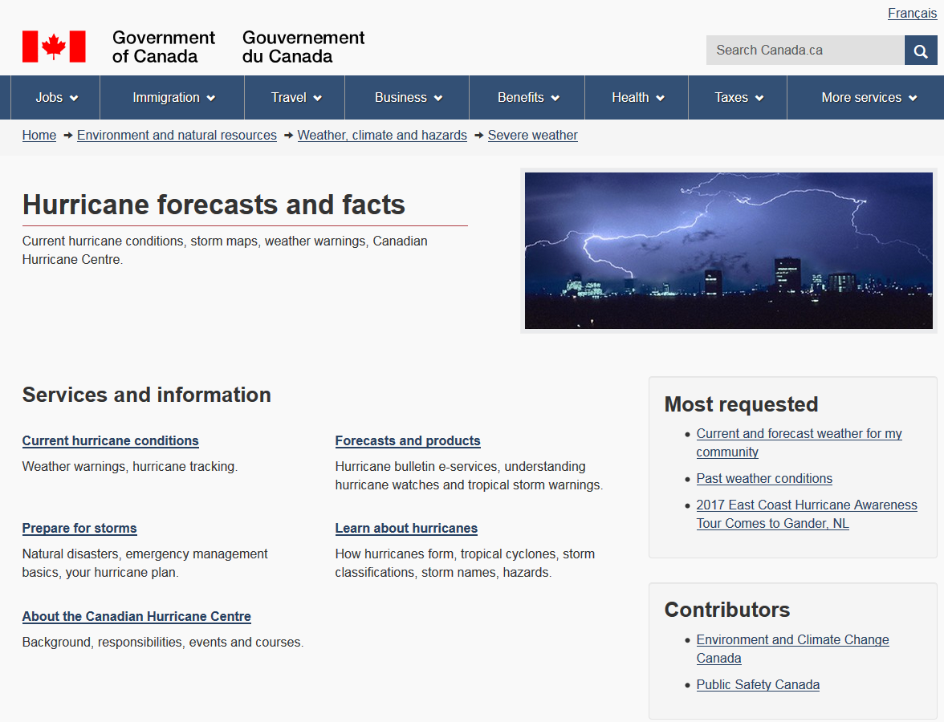
www.hurricanes.ca
Page 2 – October 31, 2019

Slide 15
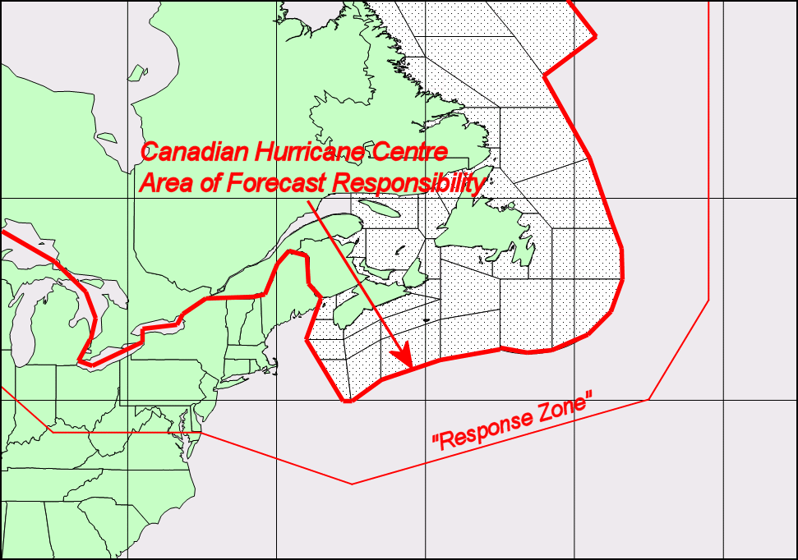
Canadian Hurricane Centre
Tropical cyclone information …
Page 2 – October 31, 2019

Slide 16
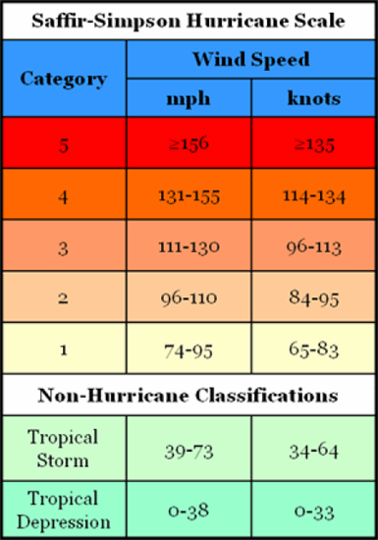

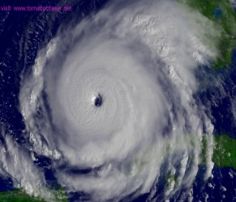


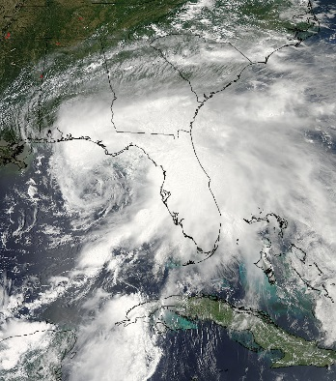

Tropical Cyclone Classification
km/h
≥252
209-251
Rita
(2005)
178-208
154-177
119-153
Debby
(2012)
63-118
62
Page 2 – October 31, 2019

Slide 17
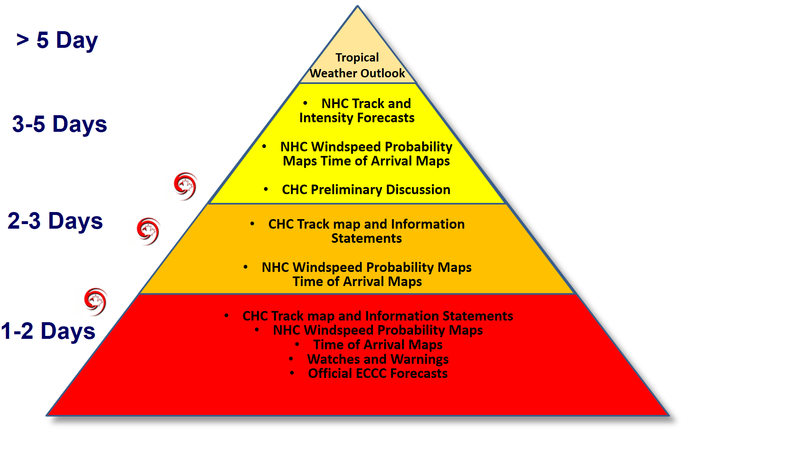
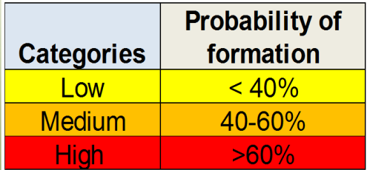
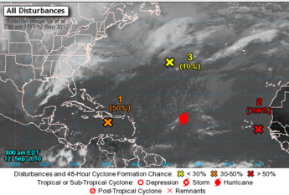
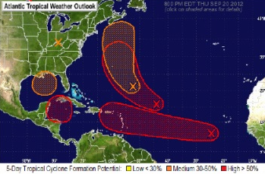
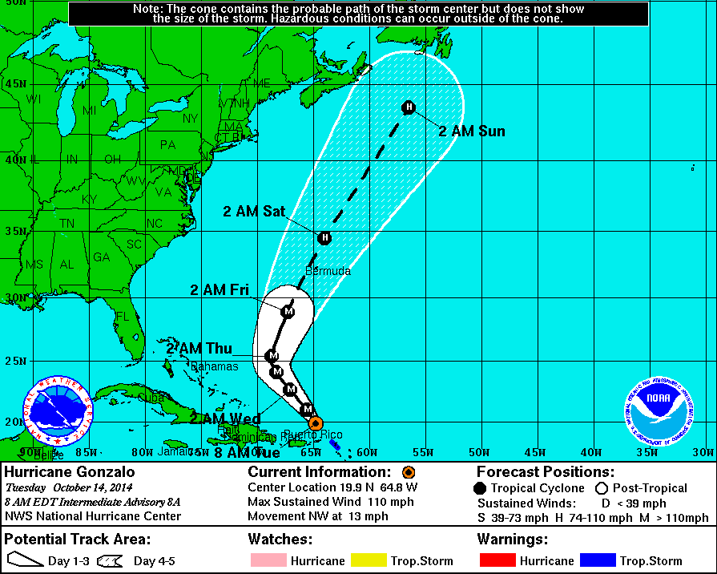
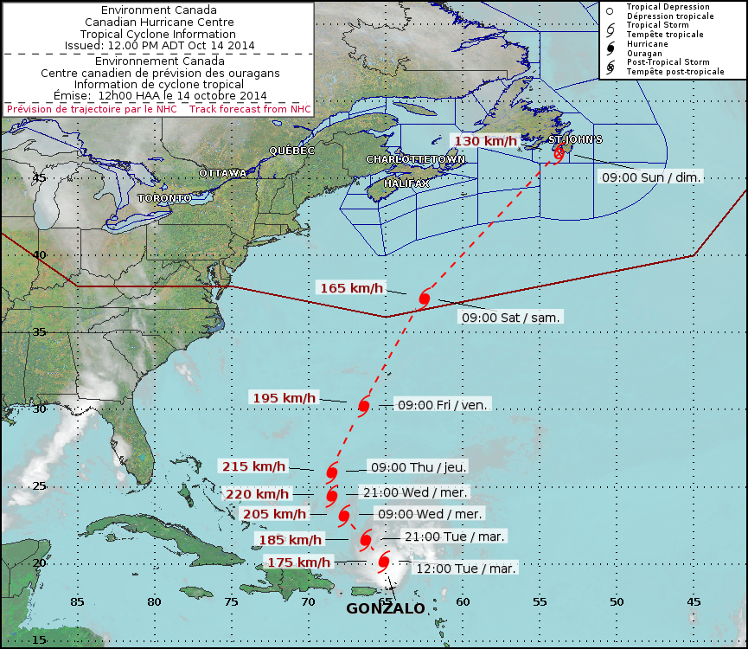
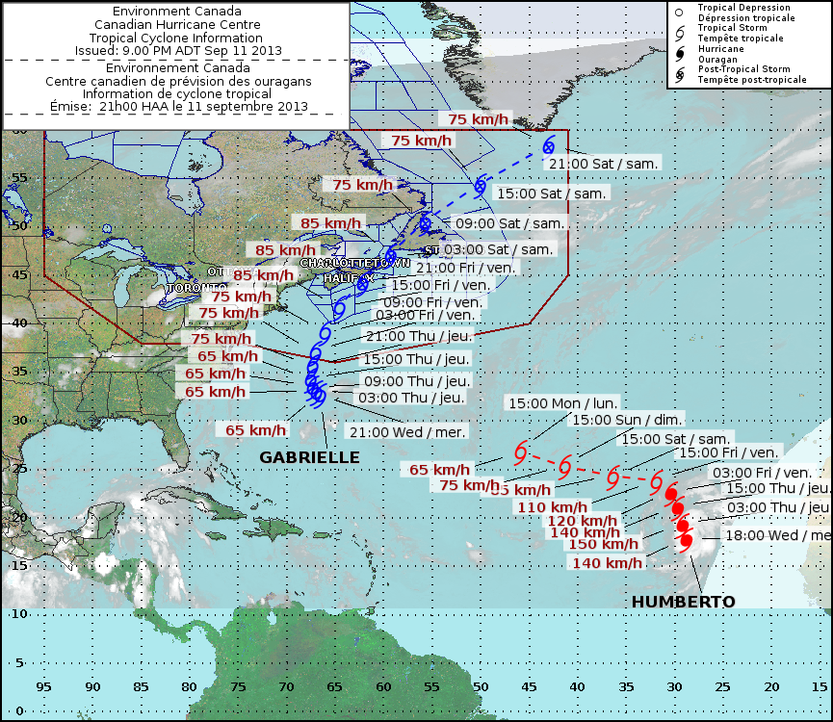
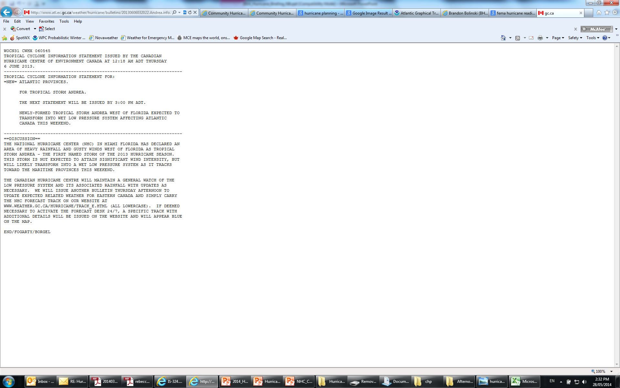
Tropical Cyclone Weather Products
Page 2 – October 31, 2019

Slide 18
ECCC Heat Warning Criteria - NB
1) At least two days meeting or exceeding Day 1 High 30°C –
Night Low 18°C –
Day 2 High 30°C
or
2) At least two consecutive days of
Humidex 36 or greater
Page 2 – October 31, 2019

Slide 19
Timeline – Exercise Charlie products
D3-7Fcst
SWSHeat
D3-7Fcst
D1-2Fcst HeatWrng SWSTrop
D1-2Fcst
D3-7Fcst
HeatWrng
DATE
May 26
May 27
May 28
May 29
Page 2 – October 31, 2019

Slide 20
Timeline – Exercise Charlie products
TrackFcst
TropCycStmt
HeatWrng
D1-2Fcst
HRA
TrackFcst
TropWrng
WeathWrng
GenWeathInfo
StormSum
WLObs
D1-2Fcst
HRA
WLGraph
TrackFcst
TropWrng
WeathWrng
GenWeathInfo
Charlie
DATE
May 30
May 31
June 1
June 2
Page 2 – October 31, 2019

Slide 21
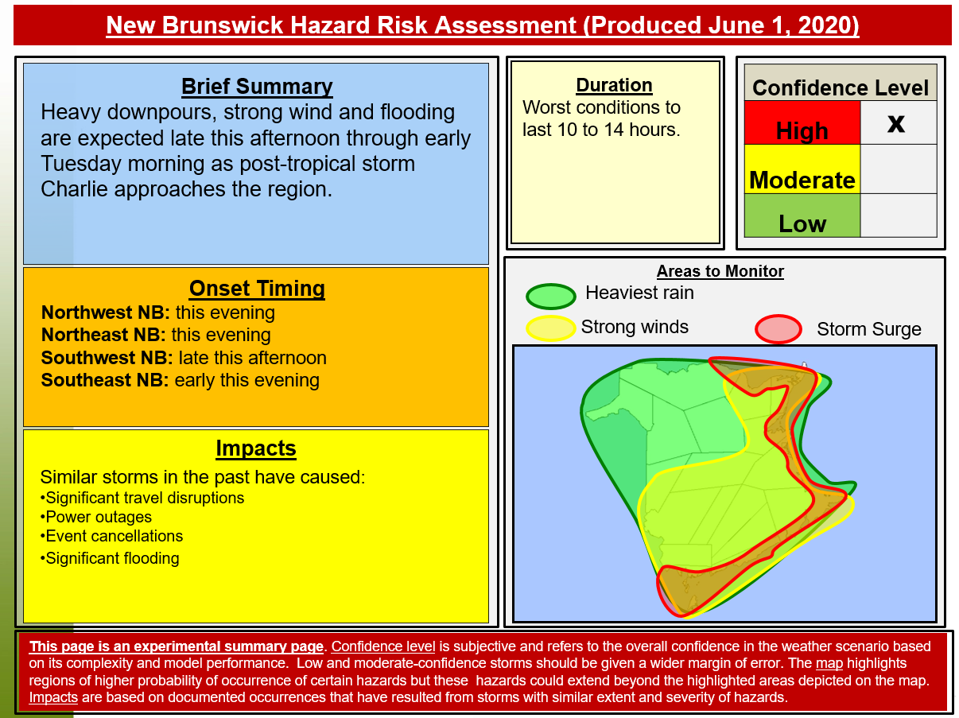
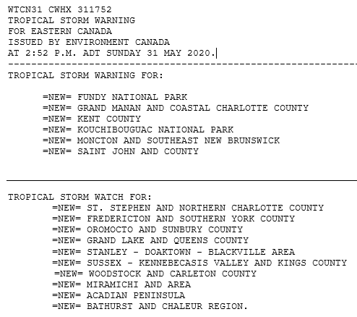
ECCC Weather Product Examples
Textual and graphical products

Slide 22
Questions???
Jill Maepea
Warning Preparedness Meteorologist
jill.maepea@canada.ca
Environment & Climate Change
Canada’s Weather Page
www.weather.gc.ca

