Slide 1

New Brunswick
Emergency Measures Organization
Air Operations
J. COOLING
Air Operations Manager

Slide 2
Remotely Piloted Aircraft System (RPAS)
Mission
It is the mission of the NB Department of Public Safety, Emergency Measures Organization, RPAS team to further public and responder safety. This includes the security of property by supporting other teams in their individual missions of Hazmat response, search and rescue, hydrometric monitoring, tactical operations and community relations.
https://www.youtube.com/watch?v=6t-hYnWPiFk

Slide 3

Aim
The aim of the NBEMO, RPAS program is to provide timely response to emergencies that require light air support by day or night. This will provide responders safe and cost effective real time situational awareness.

Slide 4
General
In emergencies that affects the lives, welfare or property of people in NB, the primary mission of NBEMO is to take necessary emergency measures to prevent the loss of life, property and the environment.
The RPAS program will provide the intelligence required to quickly assess and aid in the preparation of an Incident Action Plan during incidents, emergencies and disasters.

Slide 5
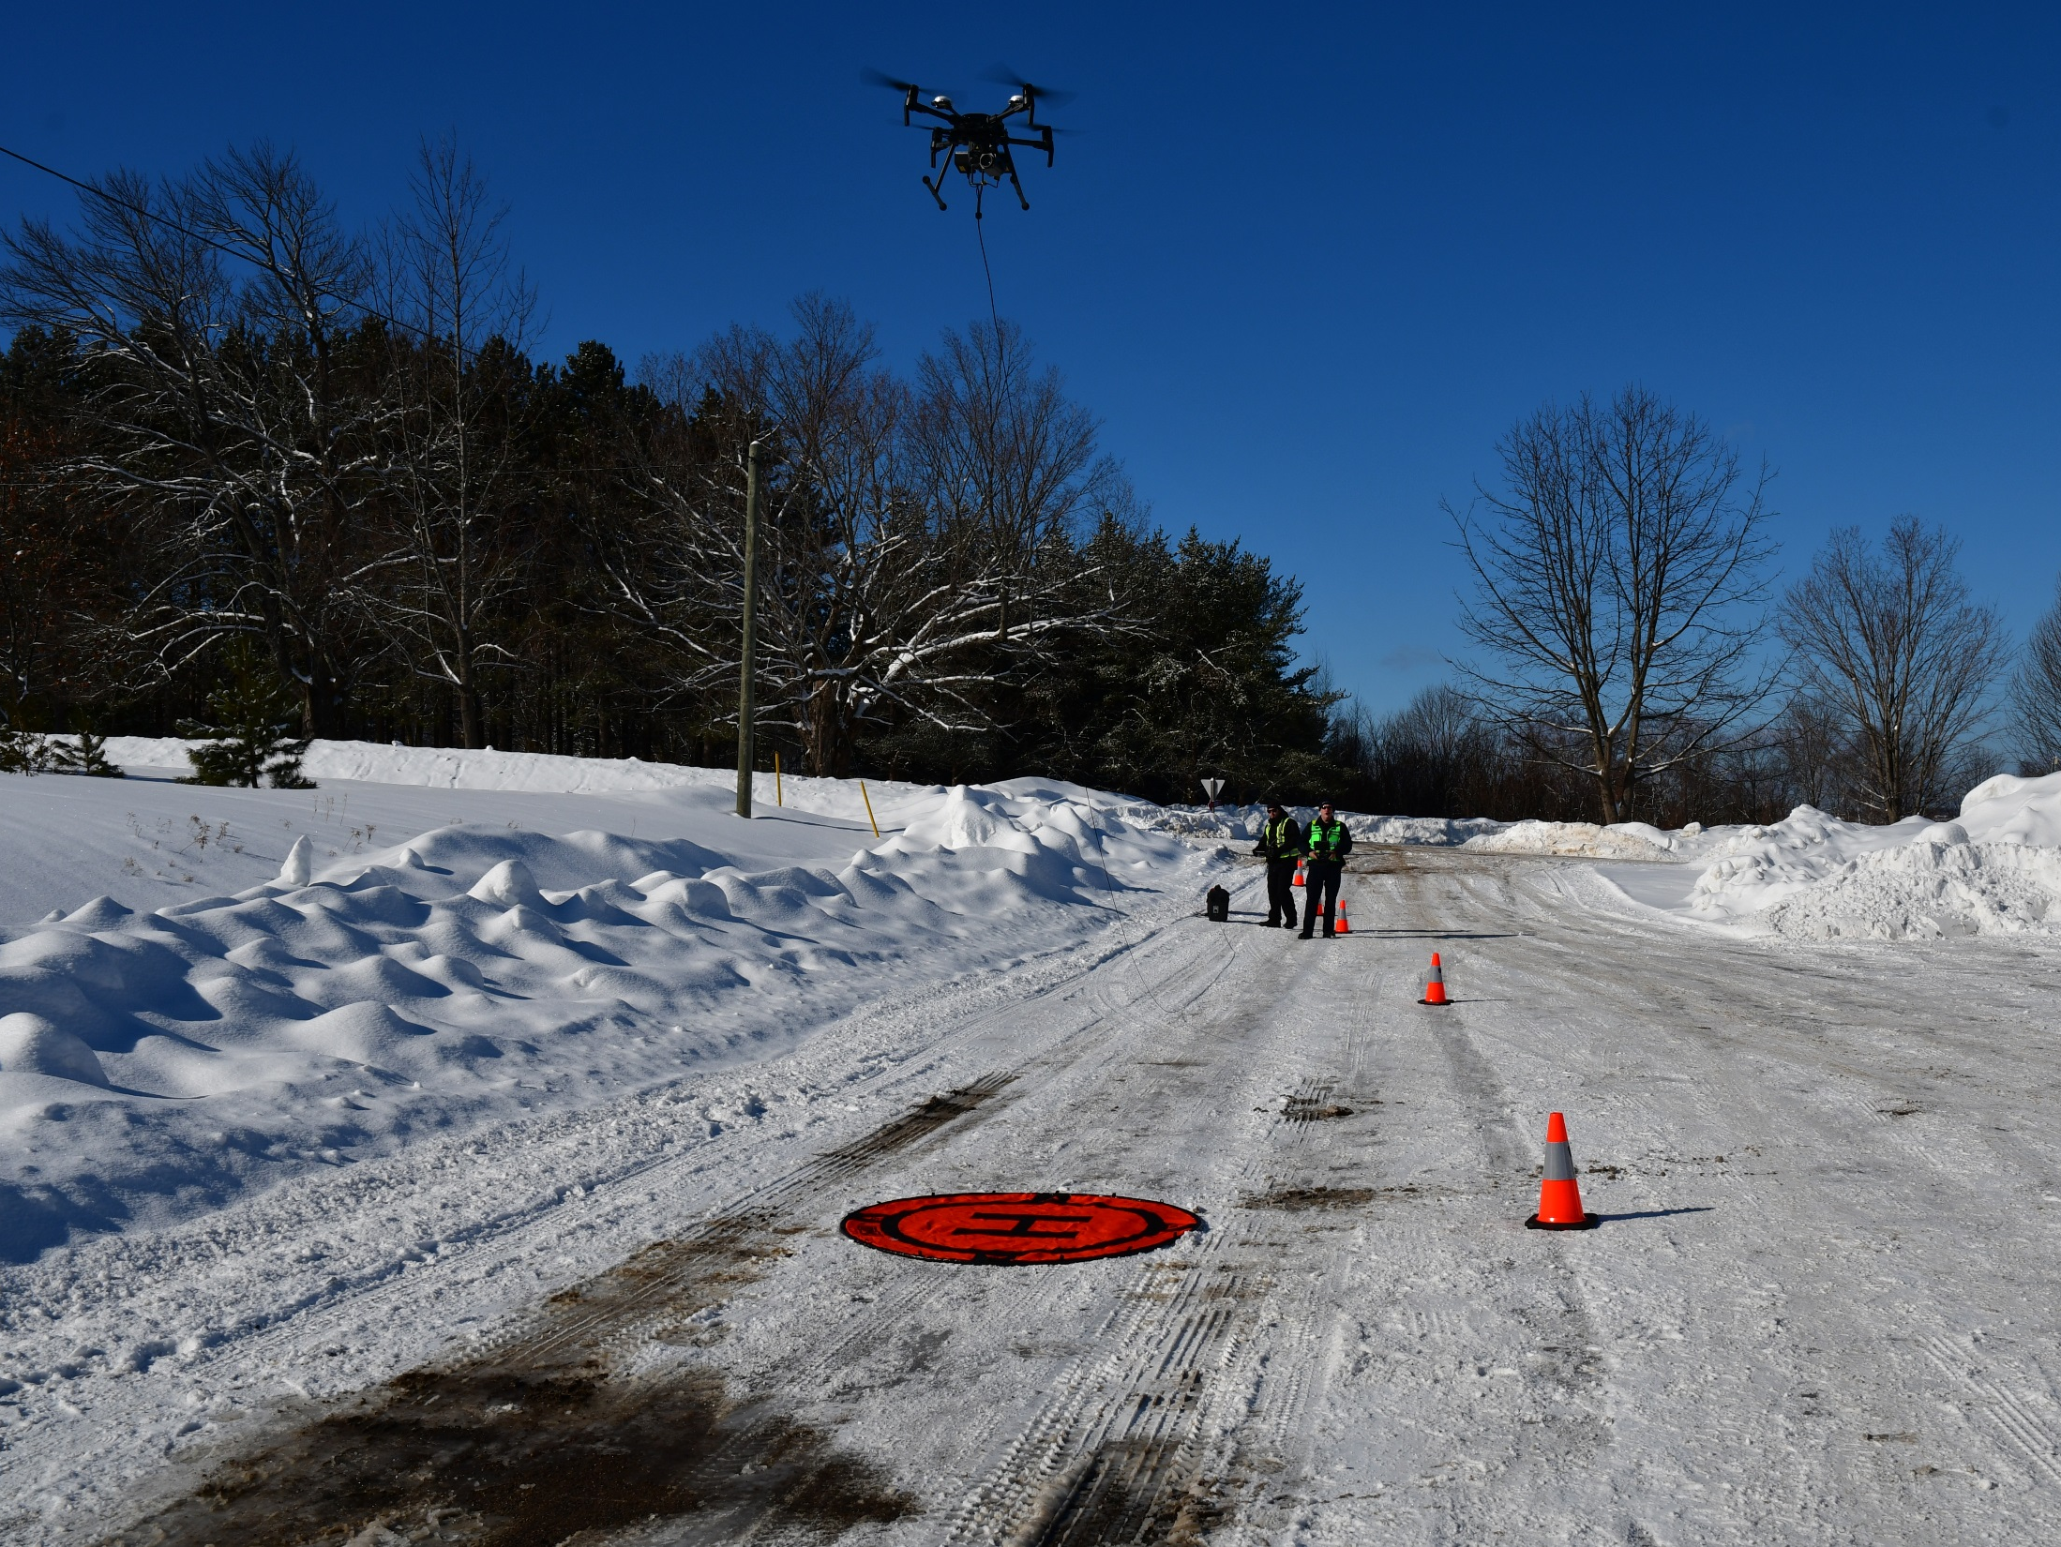
NBEMO RPAS Team
NBEMO RPAS team consists of:
Air Operations Manager & Lead Pilot – Jason Cooling
Pilot 1 – Pete Lussier
Pilot 2 – Bryce Firlotte
Pilot 3 – Ken McGee
Pilot 4 - Future Position

Slide 6
Pilot – The Pilot in Command (PIC) will have been designated by the Air Operations Manager (AOM) prior to operations being conducted.
NBEMO employs 4 Pilots, however, the designation of PIC is not assigned to any one person at all times, it is mission specific.

Slide 7
Flight Observer -all pilots secondary duty when not flying are to
provide observation to the pilot in charge.
The visual observer is responsible for sense and avoid functions while operating visual line of site (VLOS).
New Brunswick Emergency Measures Organization operates with a two person flight crew at all times. One Pilot and one Observer for all missions.
The Observer shall watch for conflicts within the operational air space, approaching weather phenomenon, bird activity etc…

Slide 8
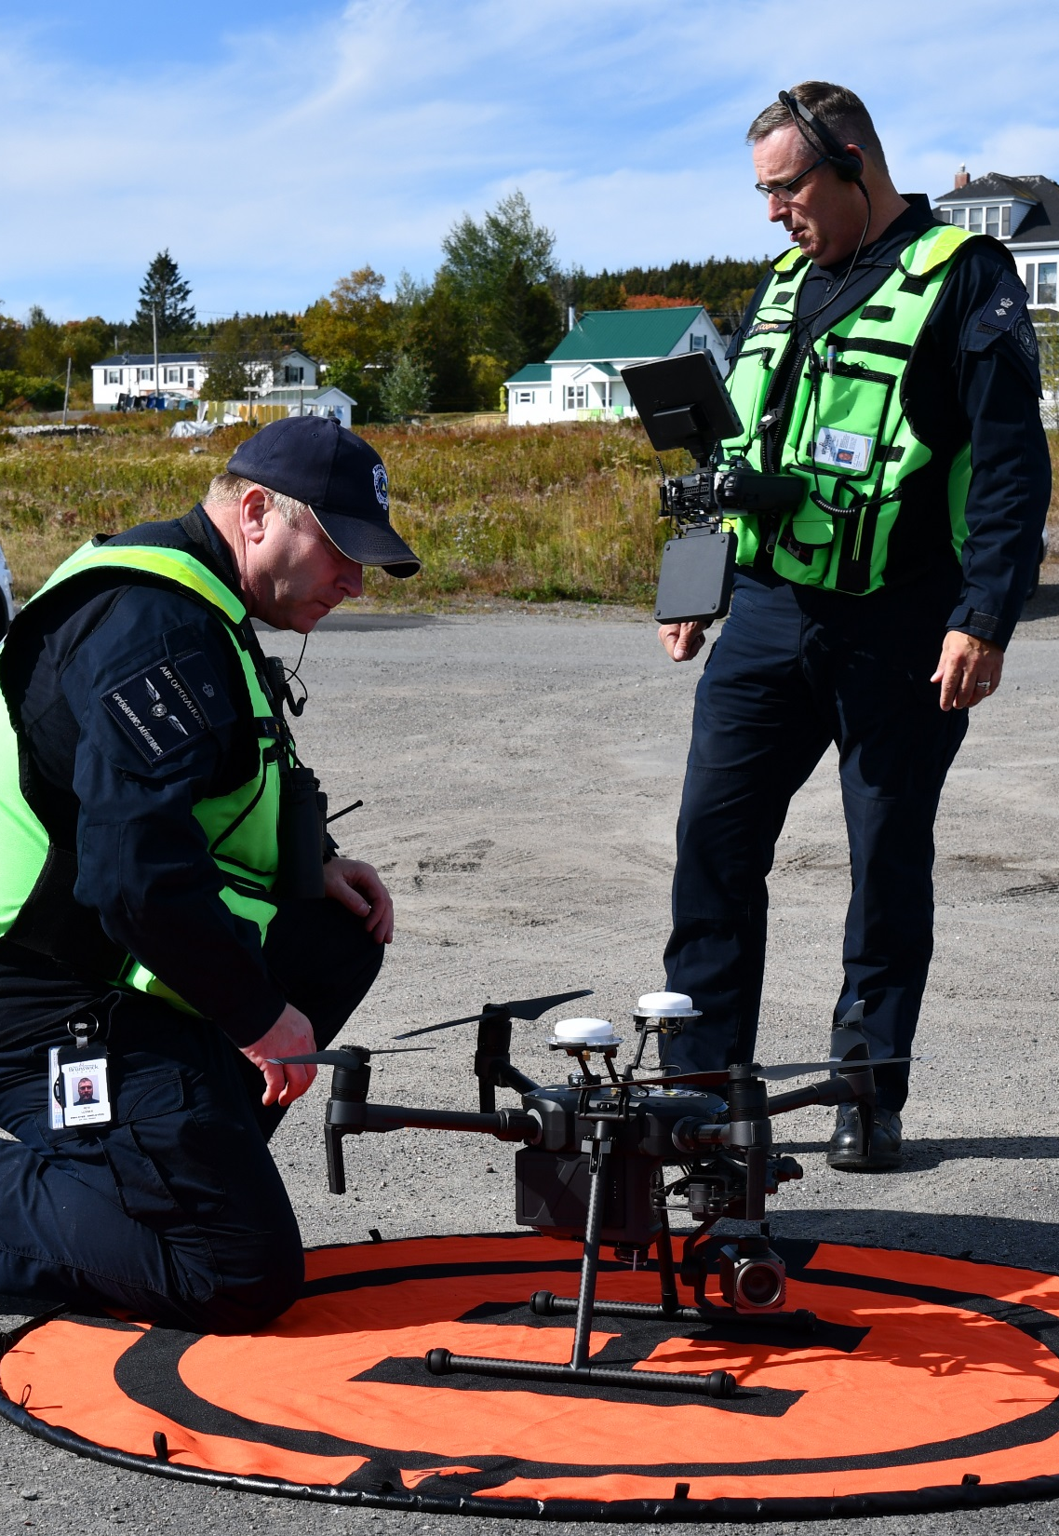
Flight Authorization
All flights shall be authorized by NBEMOs Chief of Operations and the AOM. While operational this authority may be delegated to the PIC and in conjunction with the AOM.

Slide 9
All flight releases will be deemed to have been granted when the PIC has determined that:
The flight can be conducted in accordance with the NBEMO Air Operations Manual and other applicable policies/regulations (Canadian Aeronautical Regulations);
All required licenses, permits and certificates are valid;
All required aircraft maintenance work has been completed and the aircraft is “airworthy”;
An operational flight plan or flight itinerary has been completed and filed as appropriate and in accordance with NBEMO procedures; and,
All documents and manuals as required by CARS and are available on site.

Slide 10
Flight Planning
Flight planning is to be conducted in accordance with NBEMO processes. They have developed a Pre-Operation Procedures and Checklist, as follows:
Gather operational details and situational awareness.
Perform site survey and review onsite planning.
Finalize proposed operation dates and alternate dates
Review final operational plans.
Prepare equipment and aircraft for operations – full review and check of all gear and complete aircraft check.

Slide 11
File NOTAM with local ATC if required.
Check weather leading up to and on the day of operation.
Check-in with agencies to confirm operational plans.
Arrive on site and secure staging and takeoff/landing areas.
Setup and check field kit and flight gear.
Perform aircraft inspection and ensure all systems are configured properly and fully operational.
Ensure emergency procedures checklist(s)are available and have been reviewed.
Ensure emergency ATC, NAV Canada, First Responder and any other required Local Authority contact information is available.

Slide 12
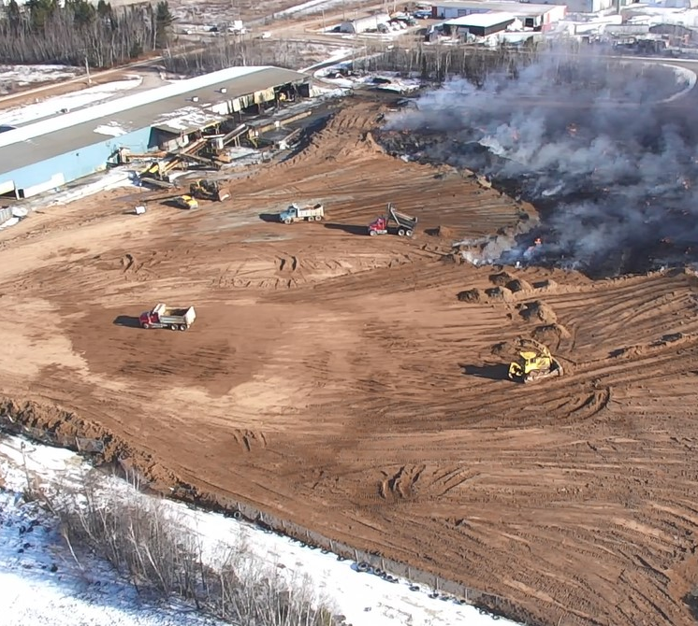
All flight operations are in accordance with Transport Canada flight operations
NBEMO works with Transport Canada and NAVCAN, as well as other Industry stakeholders to ensure a seamless transition and compliance.

Slide 13
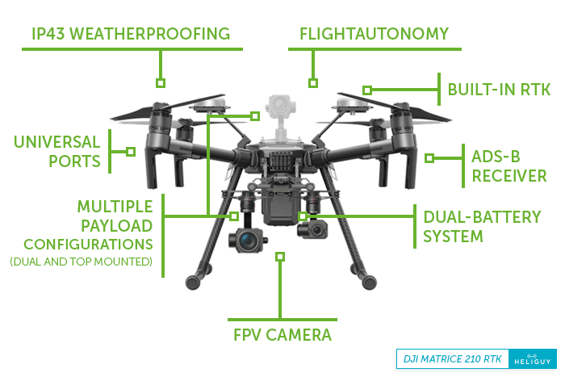
MATRICE 210 RTK
https://www.youtube.com/watch?v=xWzybek2gDw

Slide 14
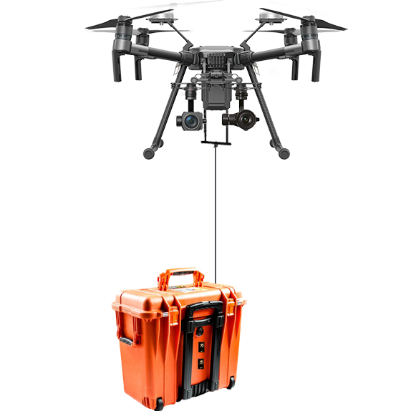
Powerline Tethering

Slide 15
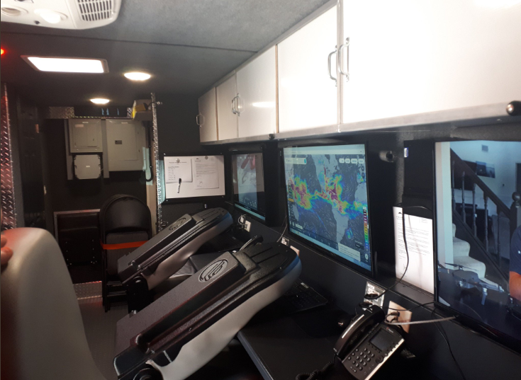
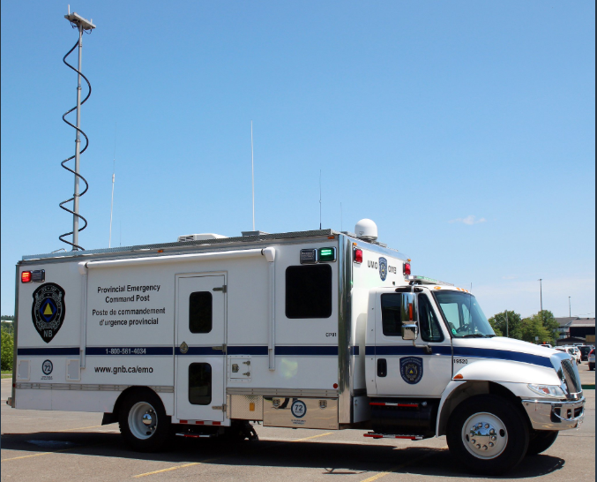

Slide 16
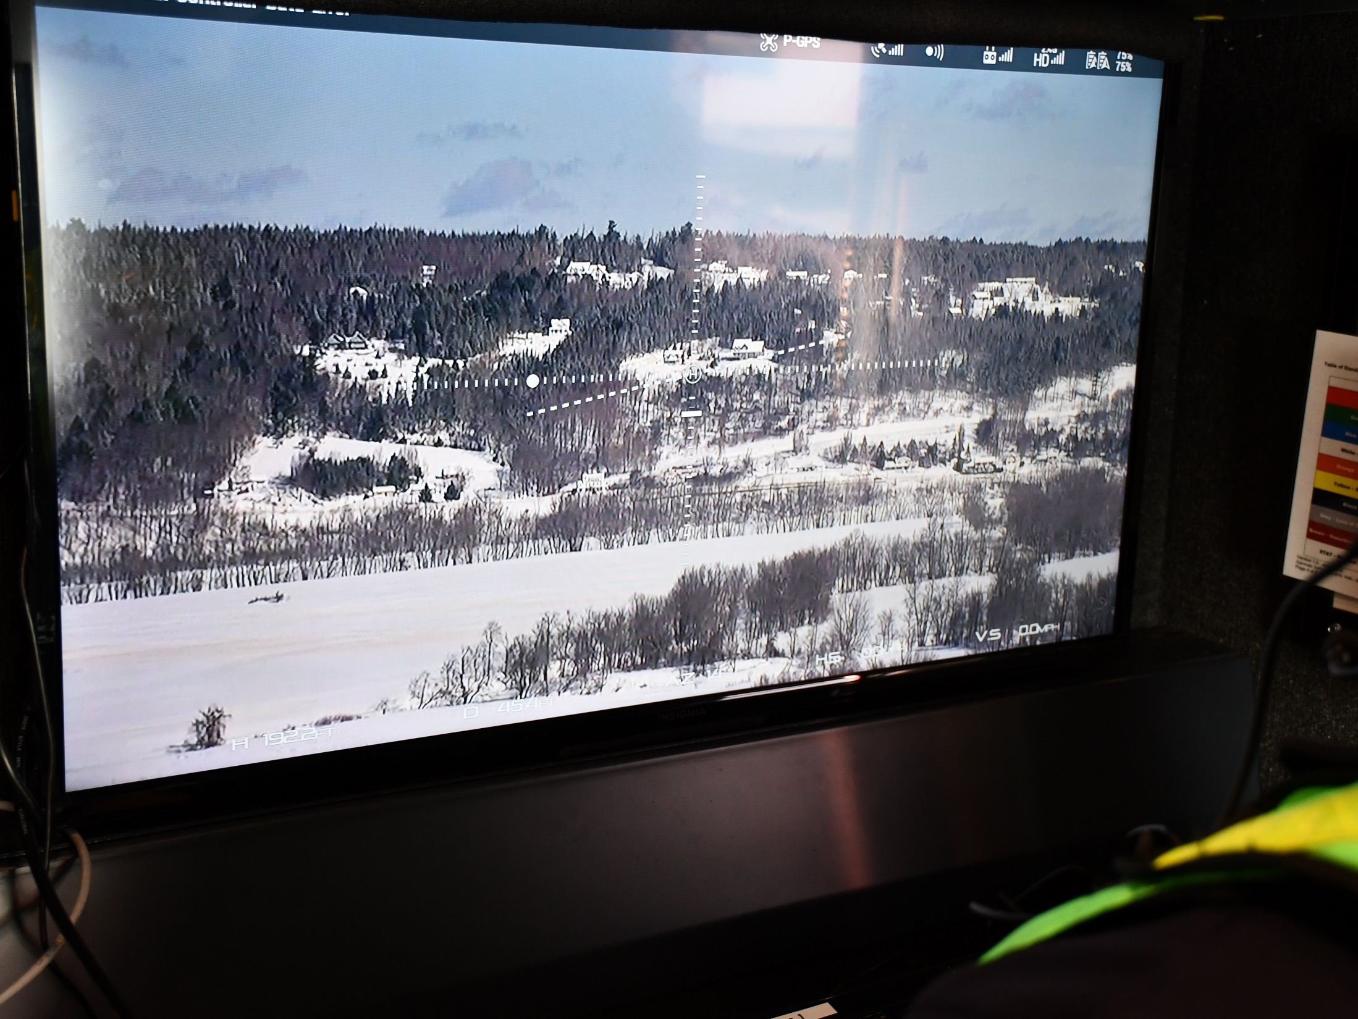
Provincial Emergency Command Post
RPAS Station

Slide 17
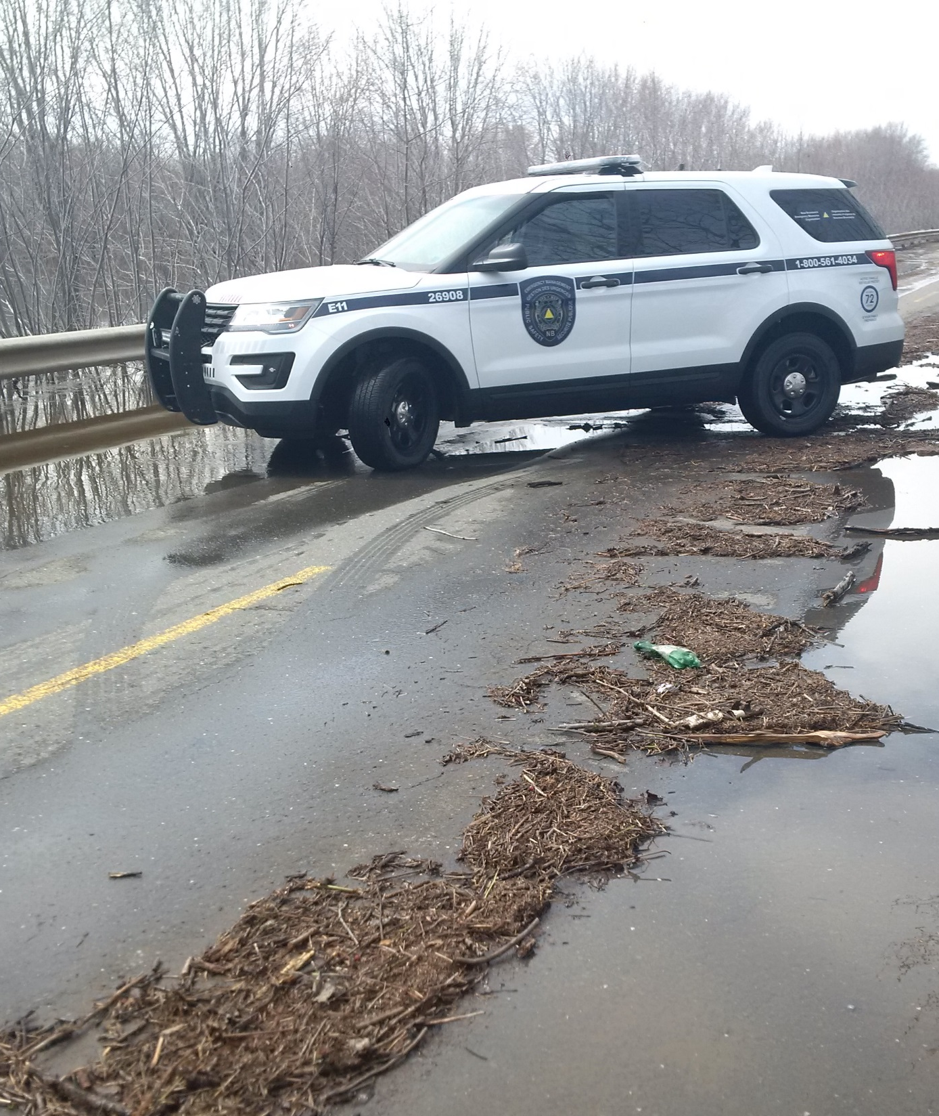
Regional Operations

Slide 18
Regardless of the level of response, responsibility for the control and conduct of the municipal emergency operation rests with the local authority.
Such local authority may receive advice and assistance from the representatives of the provincial departments and agencies through the Regional EM Coordinator and/or REAC.

Slide 19
The Regional Coordinator is ultimately responsible to the Director of NBEMO for the control of all operations undertaken in accordance with the plan.
The Director is responsible to the Minister who in turn is responsible to the Lieutenant Governor in Council.

Slide 20
Municipal requests for assistance from provincial departments will be directed to the REAC or Regional EM Coordinator.
Requests will only be accepted from an authorized municipal representative.

Slide 21
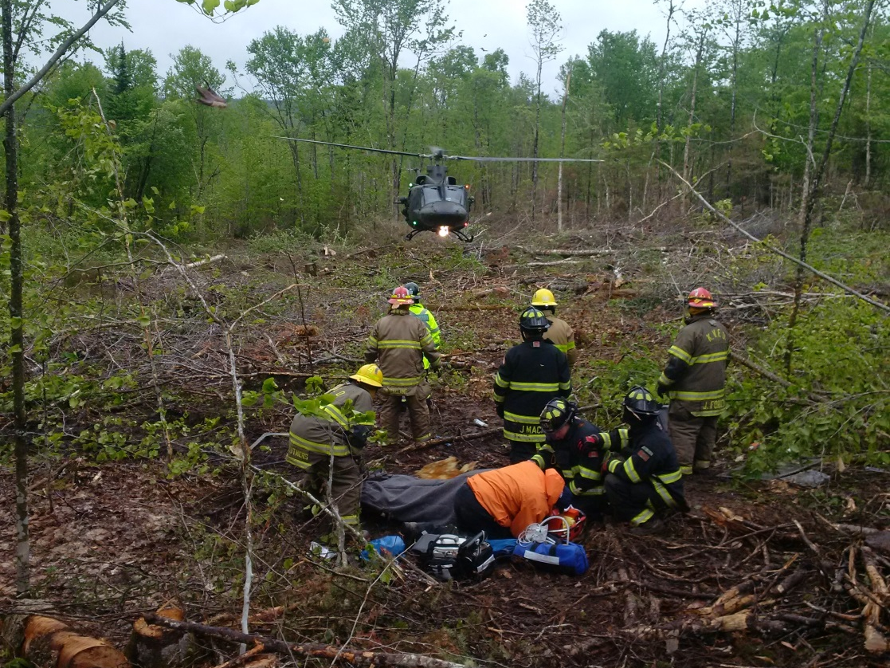
Military Request for Assistance
Medical Air Evacuation
Capital Region

Slide 22
The REAC will make an estimate of the situation and bring all available assistance to aid in controlling the situation. In the event that the Regional resources are insufficient to control the event then the Regional Coordinator may request provincial support through the Provincial Emergency Measures Organization (NBEMO).
NBEMO would determine what support is required and activate the Provincial Emergency Action Committee (PEAC) if necessary. The PEAC could in turn request federal government assistance.

Slide 23


Questions?

