Slide 1
Heat Alert and Response System HARS January 2020

Slide 2
Overview
Historical Background
Trend with worldwide temperature
Historic heat waves
What is HARS?
Printed material available

Slide 3
HARS
Heat Alert and Response System
NB History
2010: HARS-Fredericton (pilot project) Active from 2010-2019
2016-2017: HARS implemention by each Public Health Region.
2017-2020: Active in all regions

Slide 4
Vulnerable Population during a Heat wave
older adults (living alone)
young infants
homeless people
people with chronic conditions such as:
heart disease;
breathing difficulties;
diabetes;
high blood pressure;
obesity
people using certain medications
anti-depressant, anti-Parkinson, psychiatric medication,
Some antihistamines (e.g. Benadryl)
Etc...

Slide 5
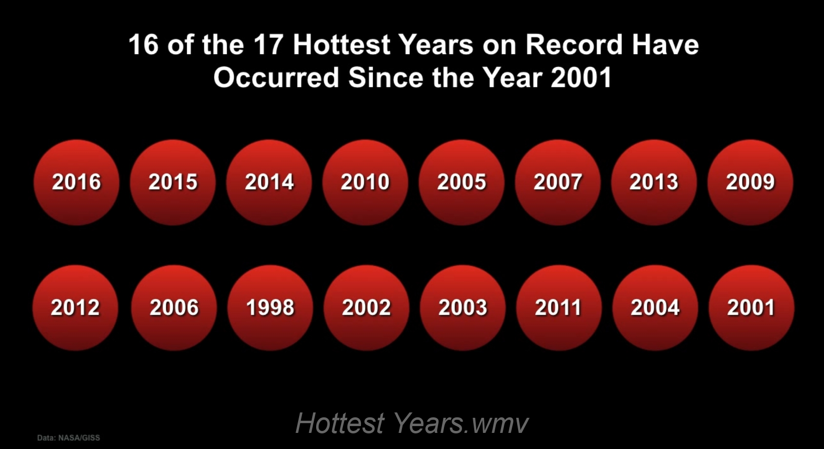
18
19
2017
2018
NASA
Notes:
2017 was 3rd
2018 was the 4th warmest year on record
May and June 2019 were the warmest ever recorded
July 2019 was the warmest on record

Slide 6
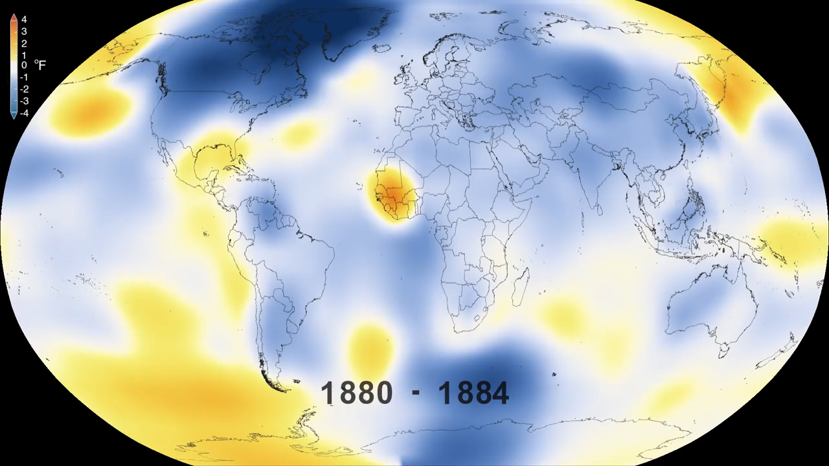
Atmosphere is getting warmer
NASA
Notes:
1.2º C since 1780
If goes unchecked, 5 degrees Celsius by 2100 ----- parts will be unliveable

Slide 7
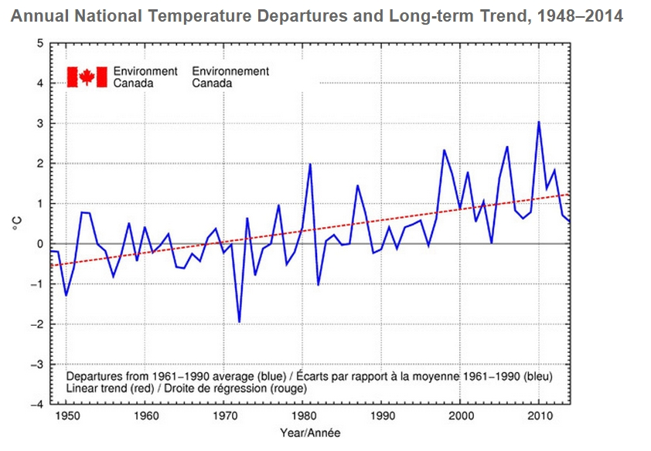
Average Temperature in Canadian
Notes:
Canada: 1.8º C since 1780
Worldwide: about 1º C
Canada is warming at a faster rate because
we have a larger land mass and a larger cryosphere
(parts of the earth where water is
frozen) in comparison to other countries.
approximately two-thirds of that rise occurring since the mid-1950s

Slide 8
Canada
1.8º C since 1780
Worldwide: about 1º C
Notes:
Canada: 1.8º C since 1780
Worldwide: about 1º C
Canada is warming at a faster rate because
we have a larger land mass and a larger cryosphere
(parts of the earth where water is
frozen) in comparison to other countries.
approximately two-thirds of that rise occurring since the mid-1950s

Slide 9
Mean temperature in Fredericton has increased by 2.1 °C
Source: ECCC 2019
Notes:
Bathurst 1.4
Moncton 1.4
Saint john 1.5

Slide 10
Mean temperature in Sussex has increased by 2.9 °C
Source: ECCC 2019
Notes:
Bathurst 1.4
Moncton 1.4
Saint john 1.5

Slide 11
Recent Deadly Heat Waves

Slide 12
Extreme Heat
Mortality Year
740 people in Chigago 1995 70,000 in Europe 2003 15, 000 in France 2003 160 in British Columbia 2009 55,000 in Russia 2010 106 in Montreal 2010
1,100 in India 2015 2,000 in Pakistan 2015
90 in Quebec 2018

Slide 13
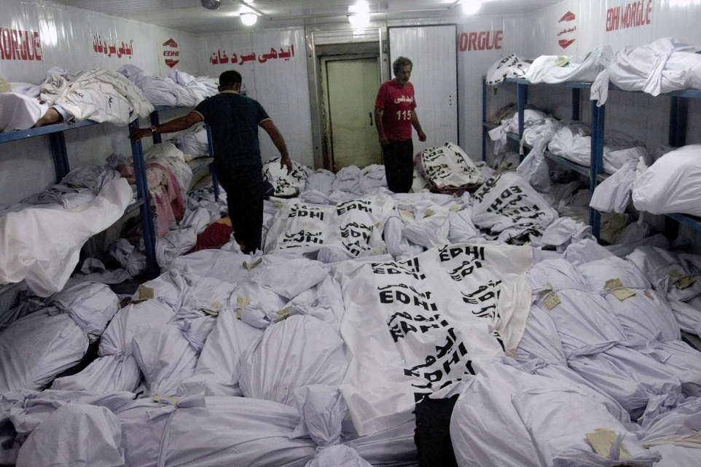
Extreme Heat
Chicago
Pakistan
Notes:
2015 Pakistan
1995 Chicago

Slide 14

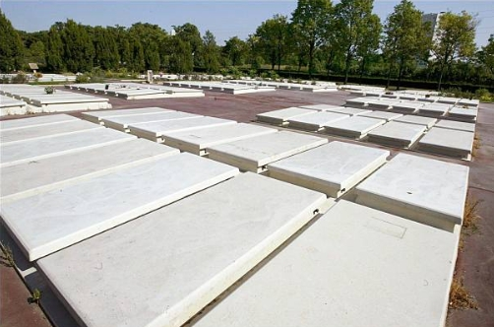
Extreme Heat
Pakistan
Paris, France
Notes:
Mass burial
2015 Pakistan
2003 Paris

Slide 15
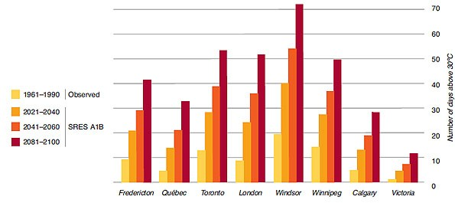
Extreme Heat
Health Canada
Notes:
Skin cancer rise? As there will be more warmer days?

Slide 16
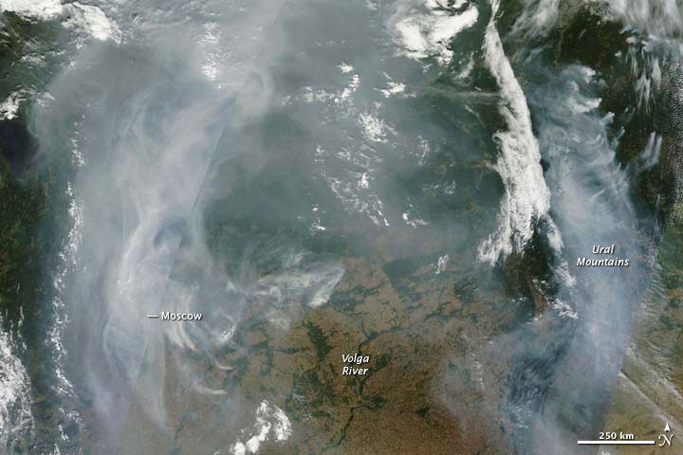
Moscow 2010
Notes:
775 Forest fires near Moscow
Australia January 2020

Slide 17
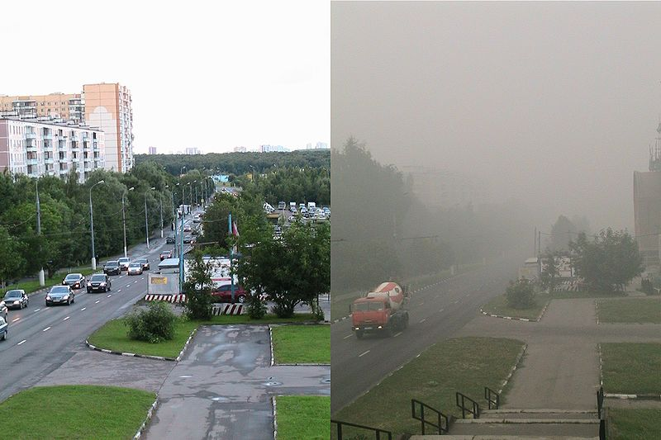
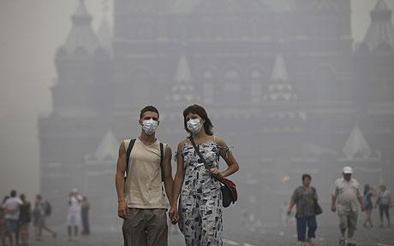
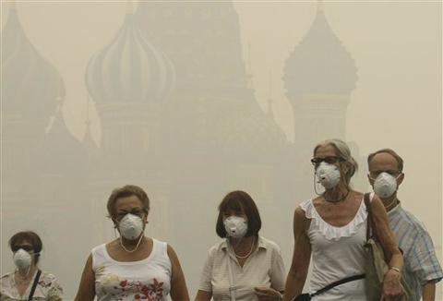

Slide 18
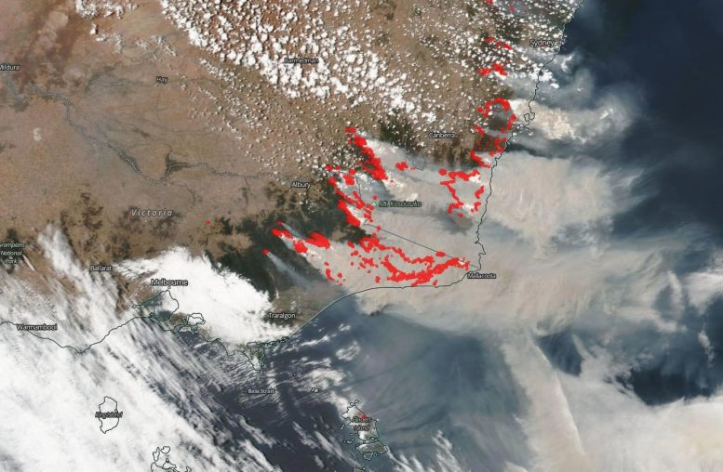
Australia January 2020

Slide 19
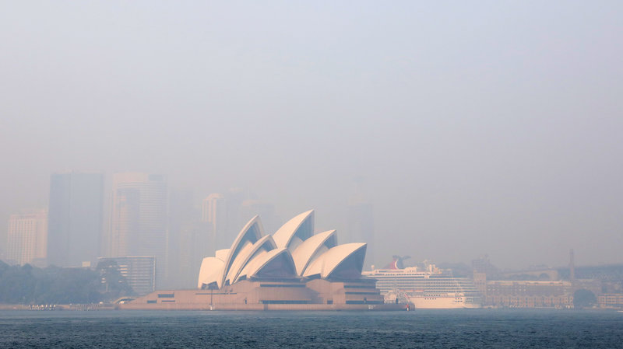
Sydney January 2020

Slide 20
Why a Heat Alert and Response System in NB?

Slide 21
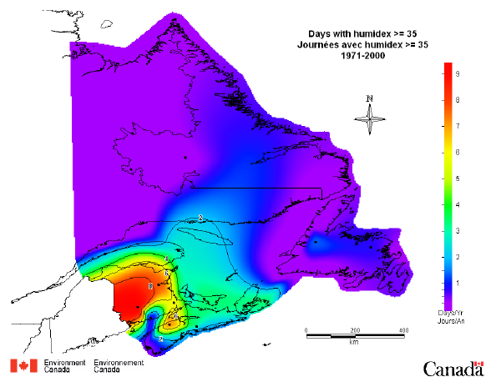
9.4

Slide 22
Homes with AC
Ontario:
Maritimes:
85 %
15%

Slide 23
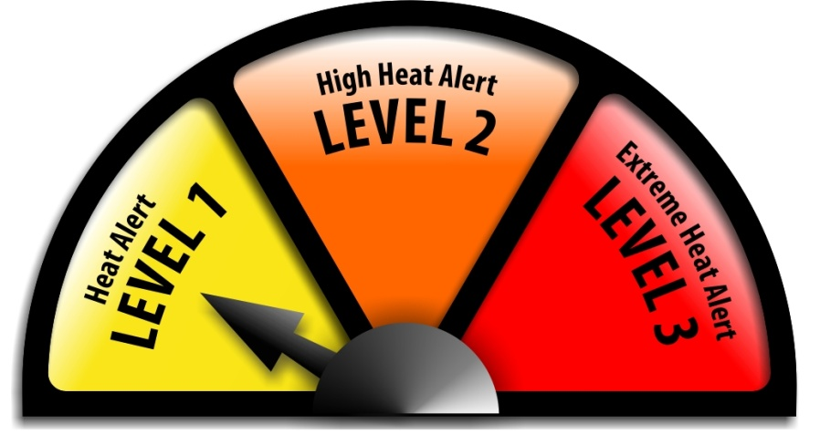
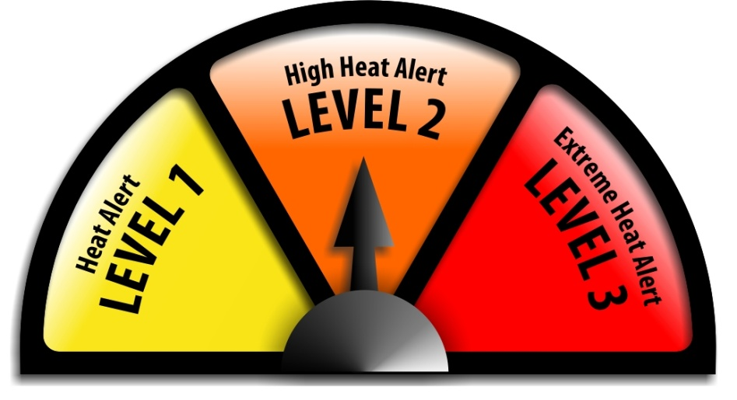
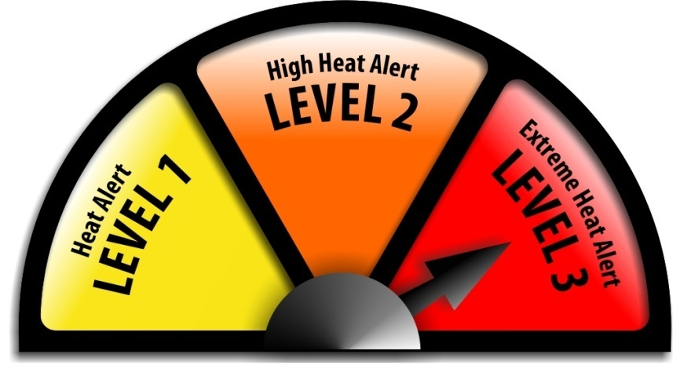
HARS Alert Levels

Slide 24


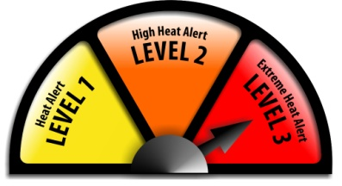
Triggers for HARS
Triggers are based on Humidex
Heat Alert – Level 1
Tmax >=30°C for 2+ days and Tmin* >=18ºC
(1st night only)
Or
Humidex >= 36 for 2+ days
High Heat Alert – Level 2:
HARS level 1 criteria is met plus either
of the 2 days reaches Humidex 40 – 44
Extreme Heat Alert - Level 3
HARS level 1 criteria is met plus either of the
2 days reaches Humidex >45

Slide 25
HARS 2017 Alerts per City
City | Level 1 | Level 2
St-Stephen | 5
Fredericton | 5
Miramichi | 1
Bathurst | 0
Caraquet | 1
Saint John | 0
Moncton | 0
Campbellton | 0
Sussex | 1
Edmundston | 0
Total: 13

Slide 26
HARS 2018 Alerts per City
City | Level 1 | Level 2
St-Stephen | 9 | 2
Fredericton | 7 | 3
Miramichi | 7 | 0
Bathurst | 8 | 1
Caraquet | 8 | 0
Saint John | 0 | 0
Moncton | 8 | 0
Campbellton | 6 | 0
Sussex | 9 | 2
Edmundston | 0 | 1
Total: 62 9

Slide 27
HARS 2019 Alerts per City
City | Level 1 | Level 2
St-Stephen | 12 | 0
Fredericton | 12 | 0
Miramichi | 3 | 0
Bathurst | 0 | 0
Caraquet | 0 | 0
Saint John | 2 | 0
Moncton | 9 | 0
Campbellton | 0 | 0
Sussex | 12 | 0
Edmundston | 0 | 0
Total: 50 0

Slide 28
HARS Flow Chart
Weather forecast (temp and humidex)
Environment Canada
Public Health Regional Office
(activates a Heat Alert)
Email
Community Response
-Outreach-
Partners
Cities
NB Health: Communication
Newspapers
Radio
TV
web
Twitter
Rss feed
Main GNB webpage

Slide 29
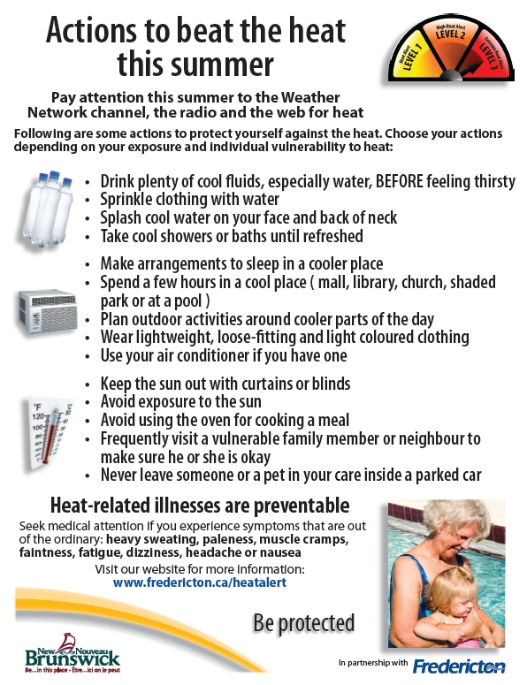
Printed Material Available

Slide 30
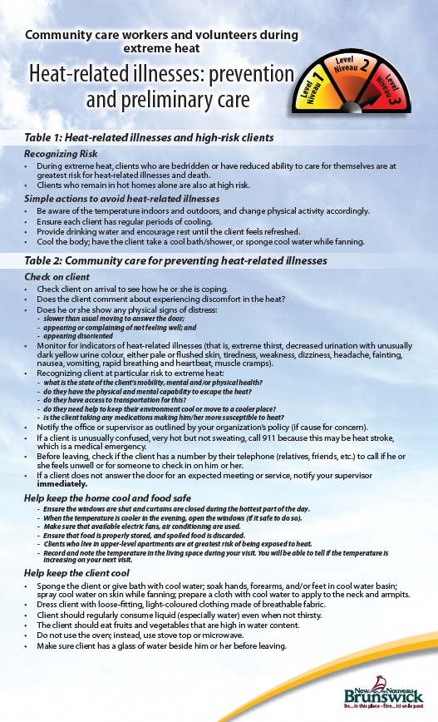

Slide 31


Slide 32
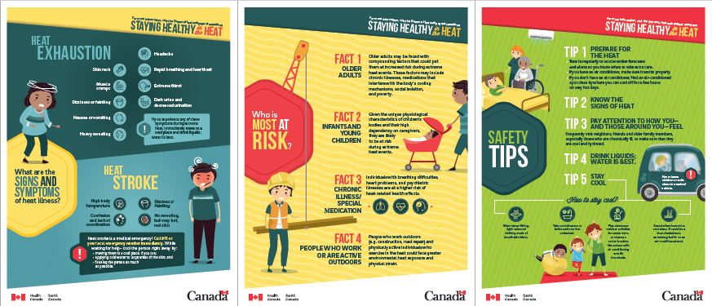
Health Promotion and Outreach
Educate the public and train health care professionals
New Infographic and Fact Sheets
30

Slide 33
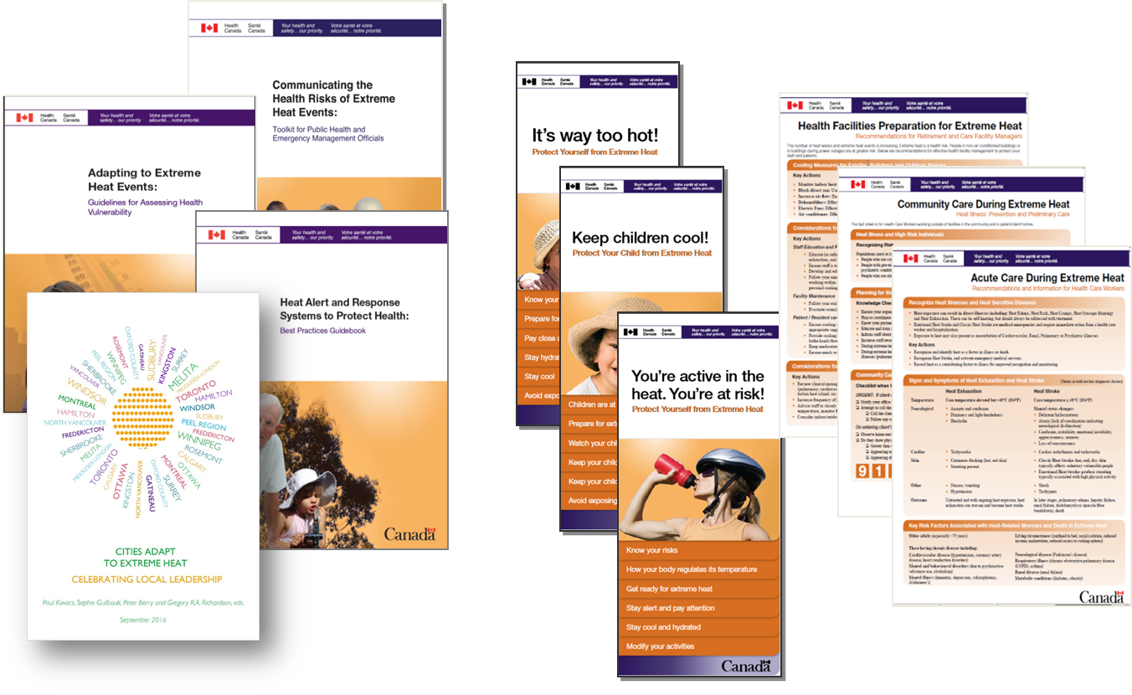
Health Promotion and Outreach
Health Canada Heat Health Publications
Wide variety of audiences
Action oriented
31

