Slide 1

Inject Development
Master Events List - MEL
Exercise Products
Lieutenant Commander Pete Gallant
Joint Task Force Atlantic
Notes:
Its that time of the process to switch the focus onto creating your injects for the exercise. The next little while I will be discussing how to develop an inject for your organization then what we do with them…kinda how it all works.

Slide 2
Inject Development
Why do I need an inject?
Injects are normally required from all organizations in order to help achieve their objectives;
Trusted Agents (TA) are the Subject Matter Experts for their organization. It is the TA who ensures the organization is working to achieve its identified objectives;
You use the inject(s) to drive reaction/work which helps to meet your objective(s);
If your organization is not planning to deliver an inject it is crucial that you assist w/ the development of any injects that you know it will be receiving as to ensure it will be received as intended
Notes:
All TAs;
If an organization is not participating but you require an inject/action from them in order to cause an effect for your organization then please indicate this so the EDT can prep it (white cell play).

Slide 3
Inject Drafting
There should be EXTENSIVE coordination between you, the Trusted Agents (TA), Regional Coordinators and/or Exercise Control (EXCON) when creating your own injects.
Key inject requirements:
Date and Time
Example 02 Jun, 0800hrs;
Delivered From - Delivered To;
Inject Method (Phone call, hand deliver, verbal, email);
Inject Details (i.e. what is to occur); and
Expected Action by Blue Player (the effect expected from the inject).
If an organization is not participating but you require an inject/action from them then indicate this so EXCON can act via white cell play

Slide 4
Inject # (EXCON use only) | Date | Time inject to be delivered | From (example: Fire Chief) | To (example: EOC)
 | 2 June 2020 | 0800 | Who the inject will be sent from | Who the inject is being sent to
Inject method (email/phone/TMR etc.) and include actual email or phone # |  | Trusted Agent name and contact information |  | Who will deliver inject (EXCON or Trusted Agent/Other
How will the inject be sent (Verbal/Phone/Email/Radio/Social Media) |  | Who created this inject and their contact information. |  | Who is going to send inject during exercise
Detailed information
FOR EXERCISE ***** FOR EXERCISE ***** FOR EXERCISE Who: From: Who will send this inject containing all information? (name, number, contact info, if it is Simulated, position) To: Who will receive this inject containing all information? (name, number or email to be contacted, is it going to EXCON or actual person) What: What is the main focus of this inject? (flooding/EOC activation/Fire/missing person etc.) When: When will this inject occur? Where: Where will this inject occur? Details: All the information and details that will be passed to the person receiving this inject. FOR EXERCISE ***** FOR EXERCISE ***** FOR EXERCISE
Instructions – Details on who will deliver this inject (i.e. EXCON acting as Fire Chief will call…..)
How will this inject be incorporated into the exercise. When it is time to insert this inject into the exercise what are the instructions on how it will be issued. Detailed out so anyone can issue this inject.
Expected action by Blue Player – The organization/person(s) receiving the inject should do what
When this inject has occurred what can be expected to happen from the exercise participants. What is the expected outcome? This will allow organizations to self-evaluate and ensure your objectives have been met.
Inject Example
Inject Example
Notes:
An Inject template has been provided for your use. You can find it on the Exercise website……
If you have any questions please do not hesitate to contact us. THIS IS WHY WE ARE HERE!!!

Slide 5
Inject # | Date | Time | From | To
 | 02 June | 1100hrs | EXCON- Fire Center | PEOC DERD Rep
Inject method |  | TA Contact information |  | Action by
Telephone - 453 - 9999 |  | Pete Lussier 111-2222 |  | EXCON
Detailed information
FOR EXERCISE ***** FOR EXERCISE ***** FOR EXERCISE Who: From: Fire Center To: PEOC DERD Rep - Eric What: Significant Fire underway in Grand Manan When: 02 Jun Where: Grand Manan near Miller Pond at 44°41'12.9"N 66°49'37.1"W. Details: Exercise, Exercise; Exercise There is a Large Wildfire on Grand Manan near Miller Pond 44°41'12.9"N 66°49'37.1"W. We have 2x Water Bombers contracted from Que with ETA 7hrs. The fire is not under control and is approx. 90ha. All avail pers enroute but no ferry services available and we are working on solution. See what can be done on your end to support. Exercise, Exercise; Exercise FOR EXERCISE ***** FOR EXERCISE ***** FOR EXERCISE
Instructions
EXCON calls DERD Rep in PEOC with fire details – not much known ATT
Expected action by Blue Player
DERD should brief PEOC and examine communities in area with view to evacuate
Inject Example
Inject Example
Notes:
Here is an inject filled out.
What it tells us is that on 02 June, Exercise Control will call the rep in the Provincial Emergency Operations Center at 11 in the morning. We will be acting as someone from the Fire Center and report to the rep about the fire as described in the details.

Slide 6
Inject # | Date | Time | From | To
 | 02 June 2020 | 1315hrs | Upper K-FD Dep Chief | Municipal Office 2369 Route 640
Inject method |  | TA Contact information |  | Action by
Phone: 460-1111 |  | Cathy Lussier- EOC Clerk 460-1111 |  | TA
Detailed information
FOR EXERCISE ***** FOR EXERCISE ***** FOR EXERCISE Who: From: Upper Kingclear FD – Dep Chief Crouse To: Pete Hackett – Hanwell Municipal Emergency Coordinator What: Fire due to hurricane-force winds tearing wires/masts from home. When: 02 June Where: Michael Avenue, Hanwell NB Details: Exercise Exercise Exercise Mr Hackett, this is the FD Chief calling to inform you that there are power lines down due to high winds from the weather; two homes on Michael Avenue in Hanwell have caught fire due to wires/masts ripped from homes. We have all available pers here and have concerns over how close this is to other structures in the area that may be affected due to the high winds fanning flames and smoke plume. FOR EXERCISE ***** FOR EXERCISE ***** FOR EXERCISE
Instructions
UKFD is on-site to fight fire; concern over how close this is to Jilly Beans daycare and other homes in the area that may be affected due to the high winds fanning flames and plume.
Expected action by Blue Player
UKFD will fight fire; Municipal EOC activated; messages sent out over social media and website; Emergency Coordinator is point-of-contact and will direct EOC participants. Discuss evac of area
Inject Example
Inject Example
Notes:
Another example and this one is the Trusted Agent will call the EM Coord at the MEOC pretending to be the dep chief from Upper Kingclear and reporting powerlines down and fires.

Slide 7
Inject Bank
An inject bank was created to assist playing communities with a wide
variety of inject examples:
Communication’s
Emergency Operation Centers
Evacuation
Fire
Flooding
GSAR
Health
Law Enforcement
Transportation
NOTE: This inject bank is available on the Exercise Brunswick Charlie Website.
https://www2.gnb.ca/content/gnb/en/departments/emo.html
Notes:
If you want or need some ideas, there is about 50 examples of injects posted on the exercise website. Please feel free to use them…just will need to modify for your particular requirements

Slide 8
All completed inject sheets should be sent to:
brunswickex1@gnb.ca
Inject sheets must be received by:
31 March 2020

Slide 9
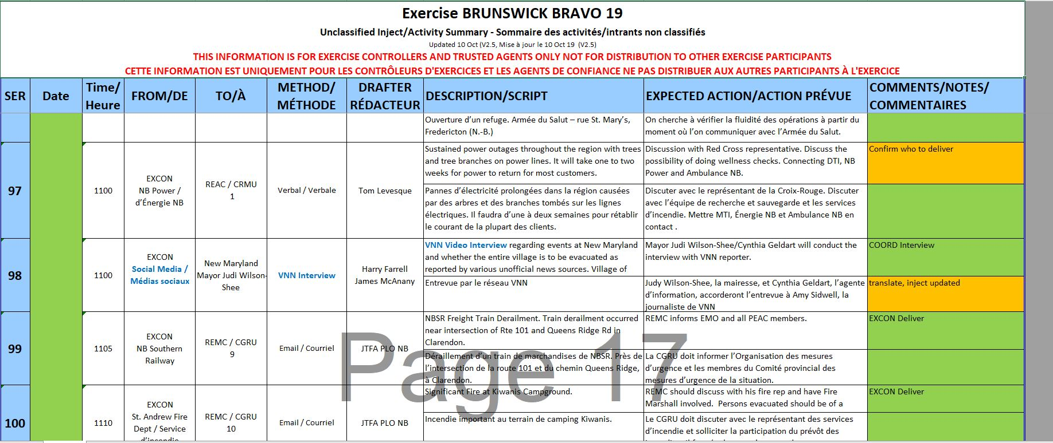
Master Event List (MEL) Example
Notes:
When an inject is received, we enter it into what is called the MEL – Master Events List. Here Is a snapshot of a page from last year. All Tas will receive this at to follow along with the overall exercise and provide some context to players if needed…make it easier to answer any questions that may come up.

Slide 10
Exercise Products
Exercise Manual containing all info required to manage exercise (player handbook and TA handbook);
MEL (Master Events List)
JTFA will provide exercise social media and exercise news media; and
ECCC will create the weather package for the exercise;
NBEMO will create warm start products (HRA, Activations etc)
Notes:
There are some other exercise products that provide as well.
We will have two manuals, a Player Manual which describes the exercise, contact info and all needed information like how to log on to exercise social media. No injects are included in this manual…don’t want to give away the surprise.
The other Manual is the Trusted Agent Handbook. This manual contains all info as per the players book but will also contain every inject sheet so that person can better understand what is occurring throughout the province.
Joint Task Force Atlantic will also provide exercise news media and Social Media aspect of the exercise. News Medial is just like what you would see on real sites. They do a super job and mix real news stories from the day with exercise news including interviews from communities and organizations
ECCC will be providing the simulated Wx Forecasts and alerts/warning during the warm start 26 May – and during the exercise
Last but not least…EMO will be issueing some warm start product as well.

Slide 11
Questions ?
brunswickex1@gnb.ca

