Slide 1

Exercise Brunswick Charlie
2020
Greg MacCallum
Director NBEMO

Slide 2

EXERCISE
Brunswick Charlie

Slide 3
Aim
A province wide exercise designed to allow those responsible for, and involved with, Emergency Management an opportunity to practice planned responses and other procedures.
This exercise like previous ones, will afford participants the opportunity, to challenge their Emergency Management and response components.
Using a new but realistic scenario, and databank of prepared injects to assist communities & add realism.

Slide 4
Scope
The scope of the exercise, developed provincially, is designed to encourage maximum participation from all municipalities , LSD’s, SAR partners and First Nation Communities within the province, regardless of their level of preparedness.
All communities & emergency management partners are encouraged to participate.
This exercise will present a new scenario that will allow participants the flexibility to prepare for impacts that could affect their citizens.
The Provincial Emergency Operations Centre along with the Regional Emergency Operation Centres will be activated for this exercise.
Notes:
Communities can participate at what ever level they desire, from the basics such as activation and communication to more in depth level for those that have more resources and want a higher level of participation

Slide 5
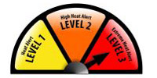
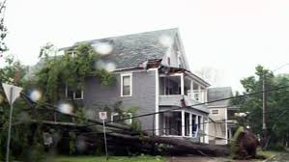
Scenario
A severe heat wave immediately followed by a short duration tropical storm will allow participants a broad scope of potential impacts. (Power outages, health emergencies, evacuations, comms interruptions, industrial accidents, fires, localized flooding, vandalism, lost persons etc…)
Simulated social media, and web based news reporting will add to the realism of the exercise.

Slide 6


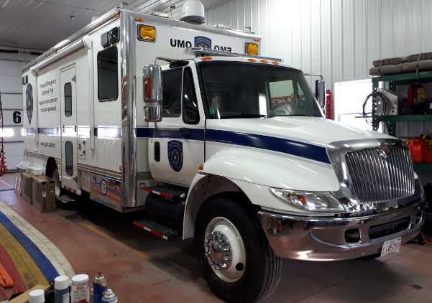







Notes:
Many of NBEMO partners have decided to take advantage of this opportunity, including ECCC, NB Power, IBC, NBTMR ,PSC and Redcross, all will add a degree of realism to the Exercise. ECCC, NB Power and and IBC will be providing short presentations.

Slide 7
Agenda
Agenda:
0930 Telephone conference lines open
0945 - 1010 Teleconference rollcall for participants on the call
1010 - 1030 Director NBEMO Opening remarks- Greg MacCallum
1030 - 1045 Exercise design concept presentation – Don Tupper
1045 - 1100 Break (Provided)
1100 - 1130 Exercise Education – Heat Alert Response System (HARS)
presentation – Public Health Stephan Hamel
1130-1200 Exercise Education – Environment and Climate Change
Canada (ECCC) presentation – Jill Maepea
1200 - 1300 Lunch (Provided)
1300 - 1345 Objectives Confirmation/Surveys – Provincial Liaison
Officer Peter Gallant
1345 - 1400 Exercise Simulation products – Capt. Adam Gorman
1400 - 1415 Break (Provided)
1415 - 1445 Scenario/inject development - Pete L.
1445 - 1500 Confirm Exercise Calendar, Q&A- Don Tupper
1500 - 1515 Closing Remarks- Greg MacCallum, Director NBEMO
Notes:
So the next presentation on the agenda is from ECCC.

