Slide 1

Exercise Brunswick Charlie
2020
Pete Lussier
NBEMO

Slide 2
Injects
All injects serve an overarching purpose: to evoke a response and cause exercise participants to make decisions or take actions that meet the exercise objectives. Injects are planned, pre-written, scheduled and allocated to a specific facilitator to deliver to one or more participants.
Exercise injects are usually delivered by exercise control ( EXCON) or trusted Agents( TAs)

Slide 3
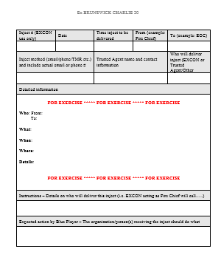
Inject form for Ex BC 2020
Notes:
Communities can participate at what ever level they desire, from the basics such as activation and communication to more in depth level for those that have more resources and want a higher level of participation

Slide 4
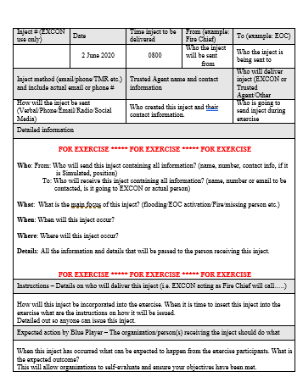
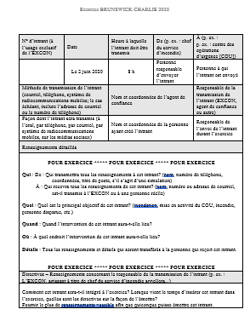


Slide 5
Inject Bank
An inject bank will be created to assist playing communities with a wide
variety of inject examples:
Communication's
EOC
Evacuation
Fire
Flooding
GSAR
Health
Law Enforcement
Transportation
NOTE: This inject bank will be available on the Exercise Brunswick Charlie
Website.
Notes:
Many of NBEMO partners have decided to take advantage of this opportunity, including ECCC, NB Power, IBC, NBTMR ,PSC and Redcross, all will add a degree of realism to the Exercise. ECCC, NB Power and and IBC will be providing short presentations.

Slide 6
Questions
Notes:
So the next presentation on the agenda is from ECCC.

