Slide 1

"So Others May Live"
P
Professional Volunteers - Serving the Community
February 2020

Slide 2
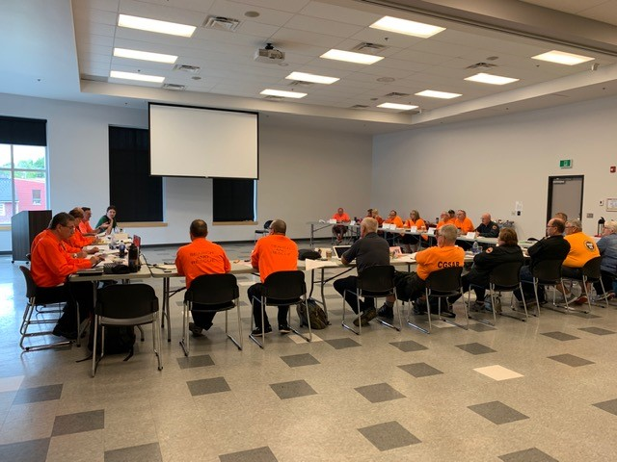
What we do:

Slide 3
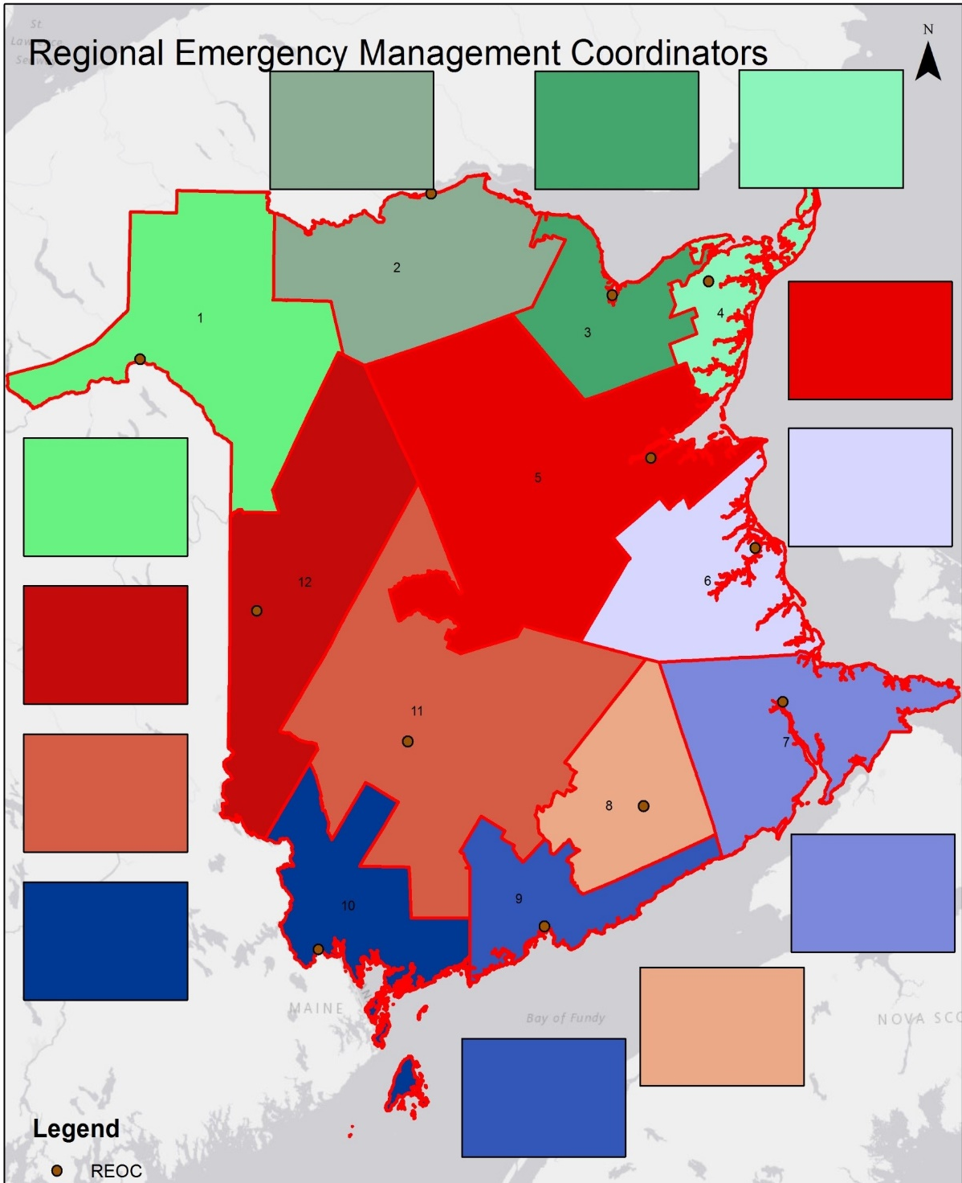
GSAR Boundaries
align with
EMO and RSC
North west Acadie Chaleur GSAR
Acadie - Chaleur
GSAR
Acadie –
Chaleur
GSAR
(
Miramichi
GSAR
North West
GSAR
Tri County
GSAR
Carleton
GSAR
Map Slide
YSSR
GSAR
Tri County
GSAR
Charlotte
County GSAR
Greater Fundy
GSAR
River valley
GSAR
9 Teams covering 12 regions

Slide 4
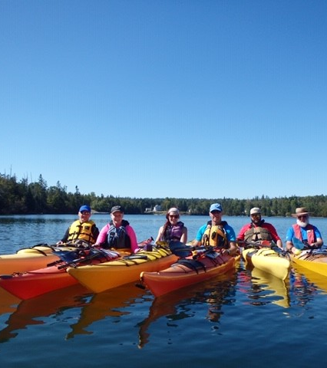
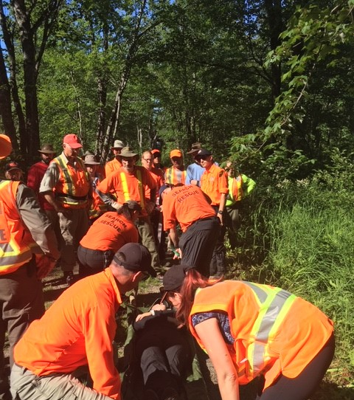
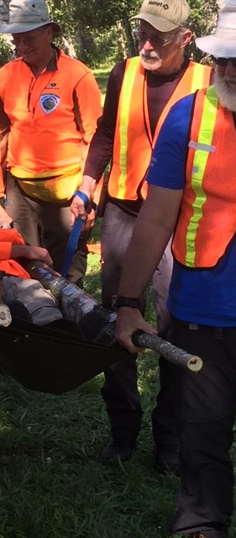
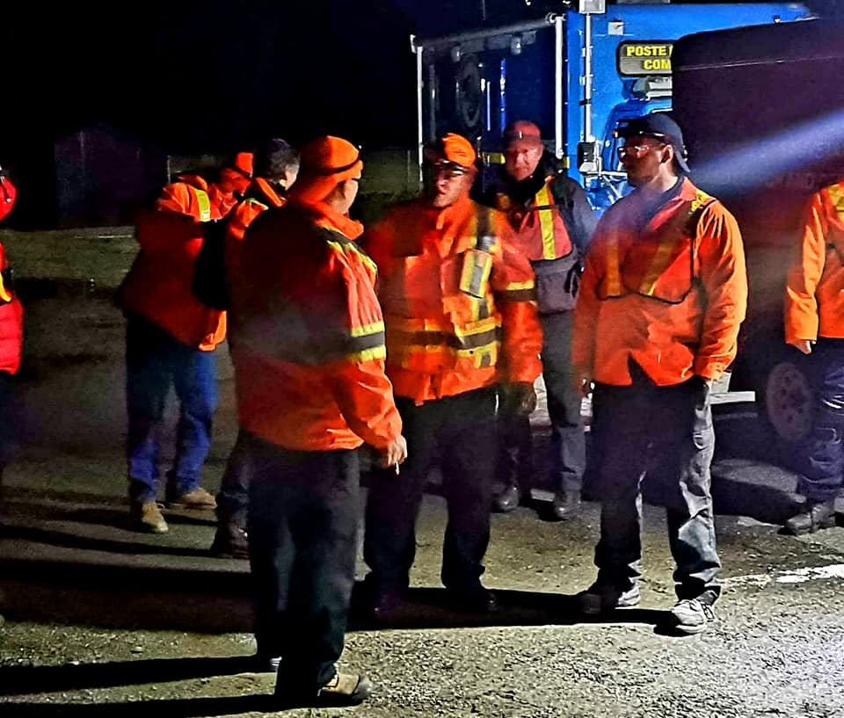
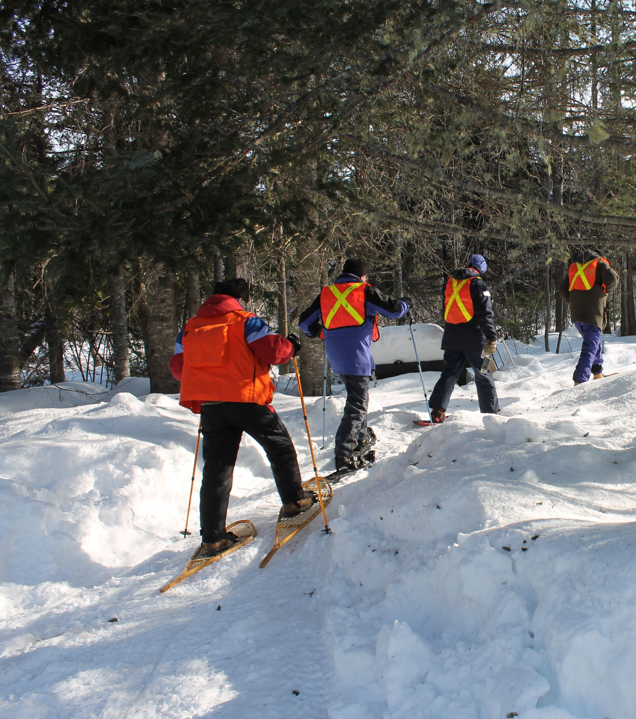
Rain, snow, or 20 below – we go!

Slide 5
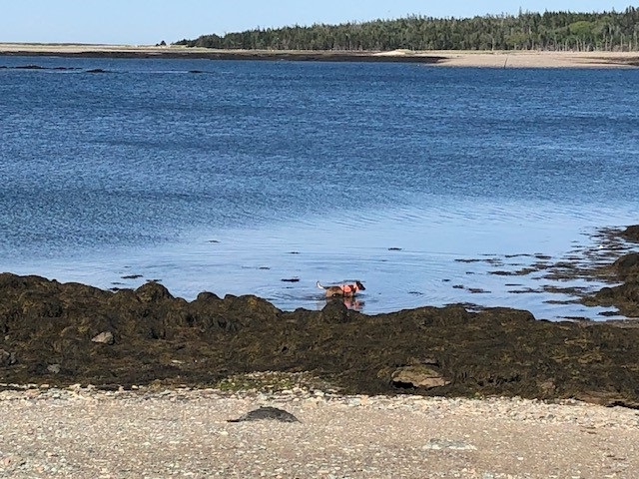
Our Search Area :
72,908 Square Km's of terrain
5,500 Km's of coastal shoreline
And an International border

Slide 6
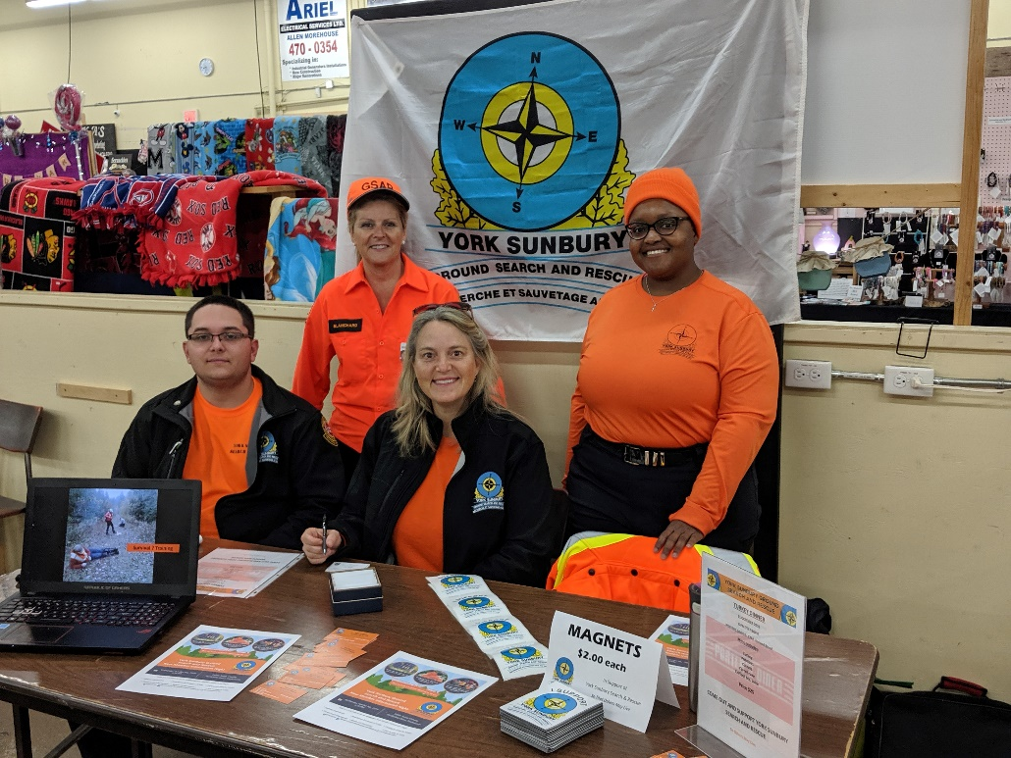
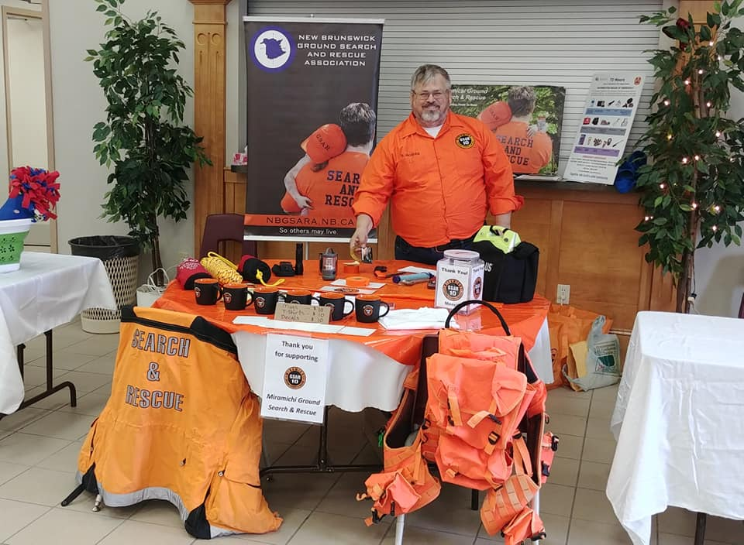
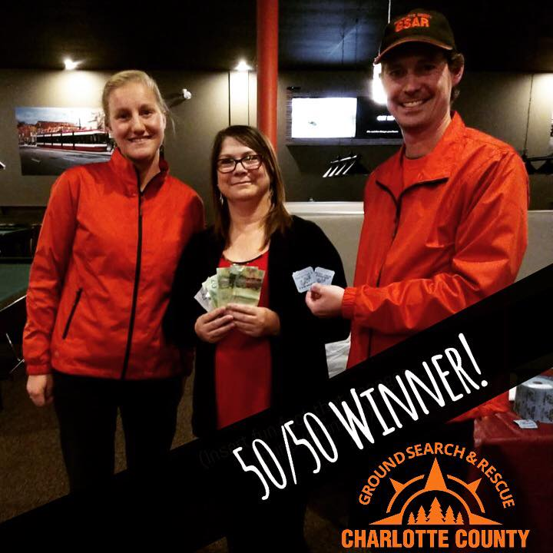
Fundraising

Slide 7
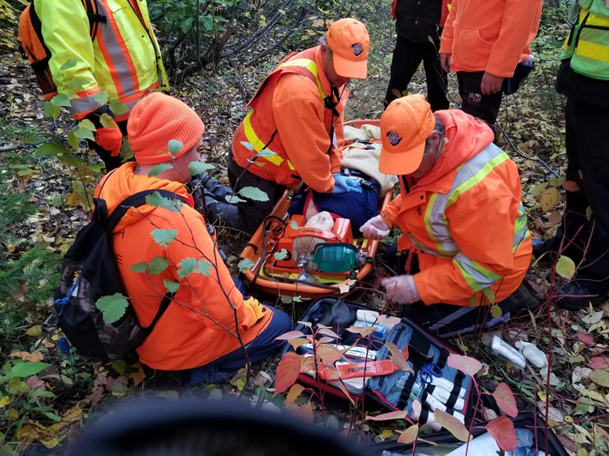
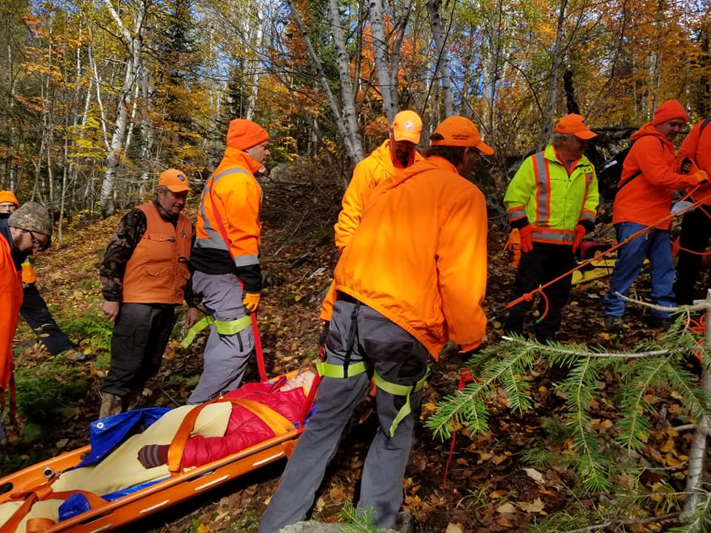
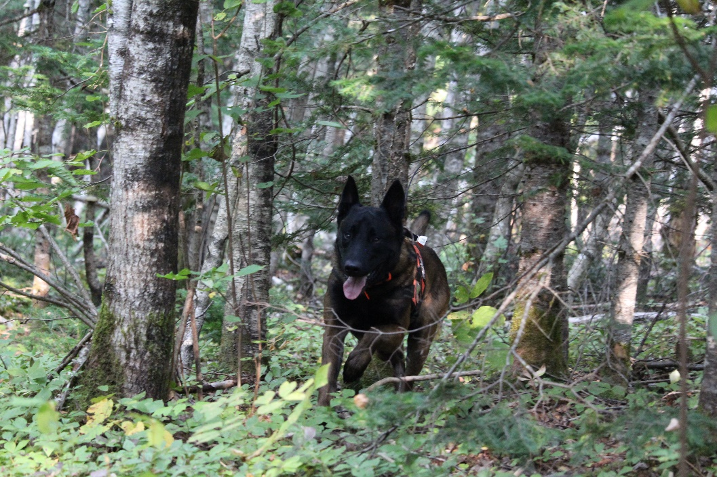
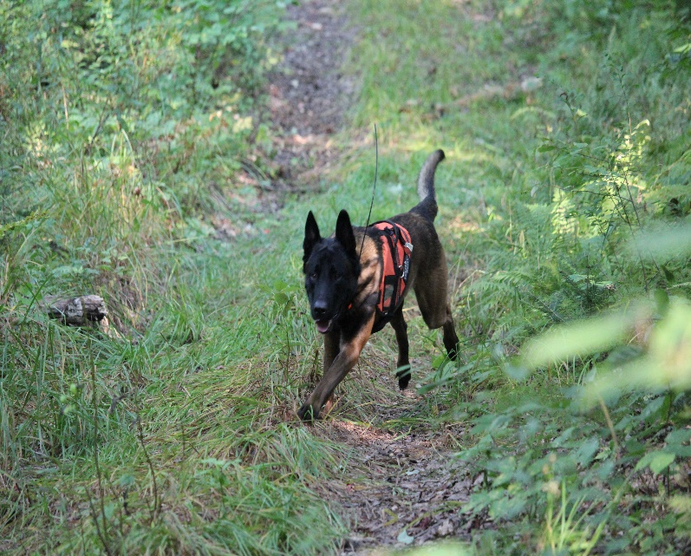
2019 Statistics
48,000 volunteered hrs
3500 search hours
60 Activations

Slide 8
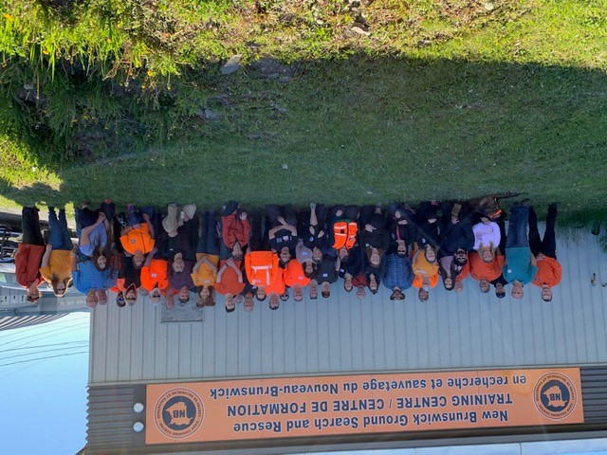
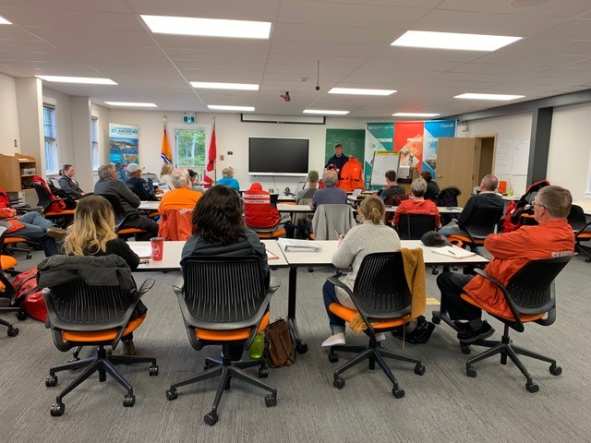
Weekend training in Miramichi, part of the 3 year SARNIF project
Preparing for water exercises with
Canadian Coast Guard

Slide 9
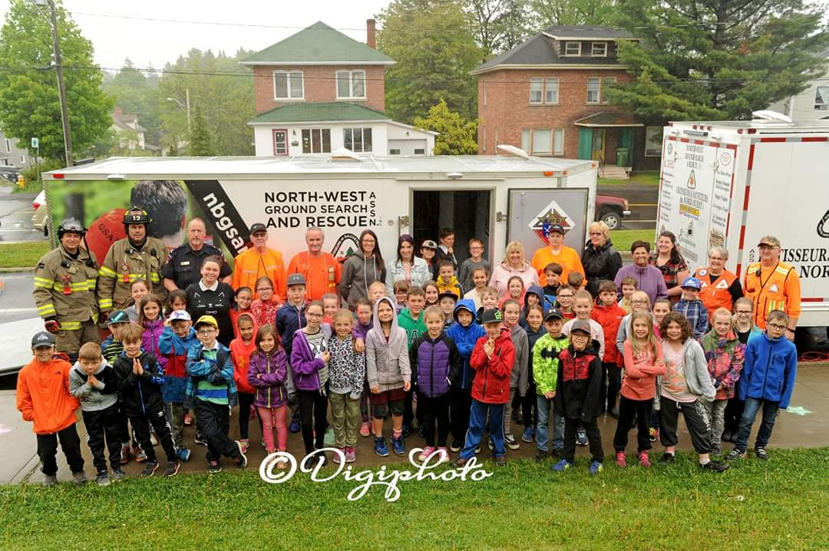
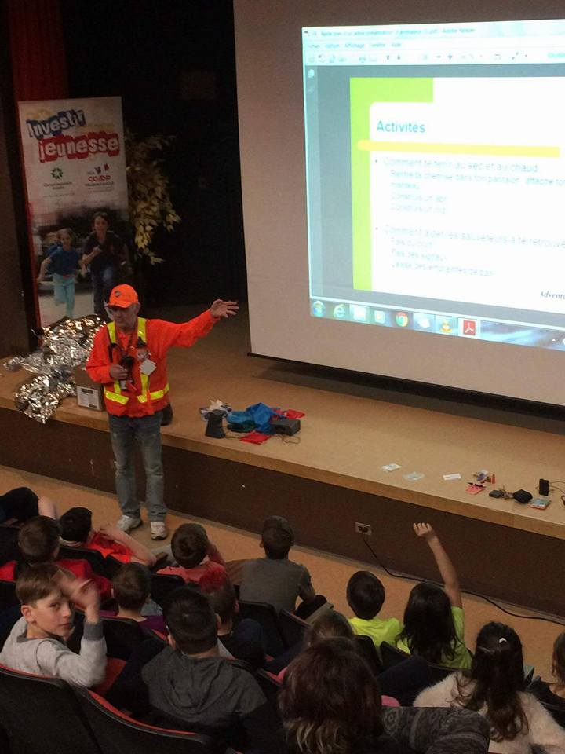
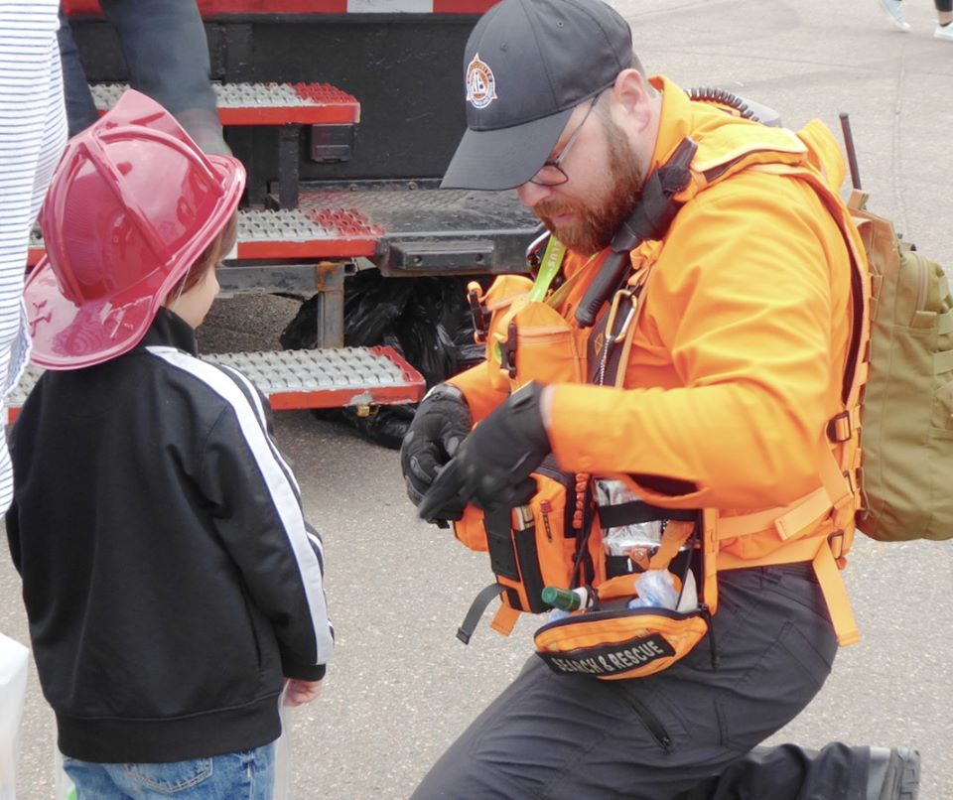
Public Awareness

Slide 10





Hug a Tree – Stay Safe

Slide 11


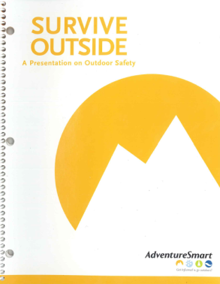

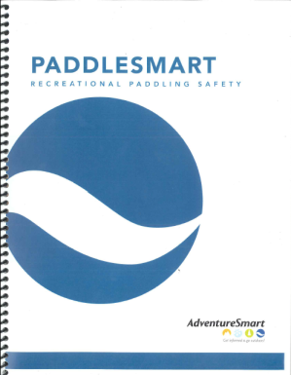

Adventure Smart Programs
adventuresmart.ca

Slide 12
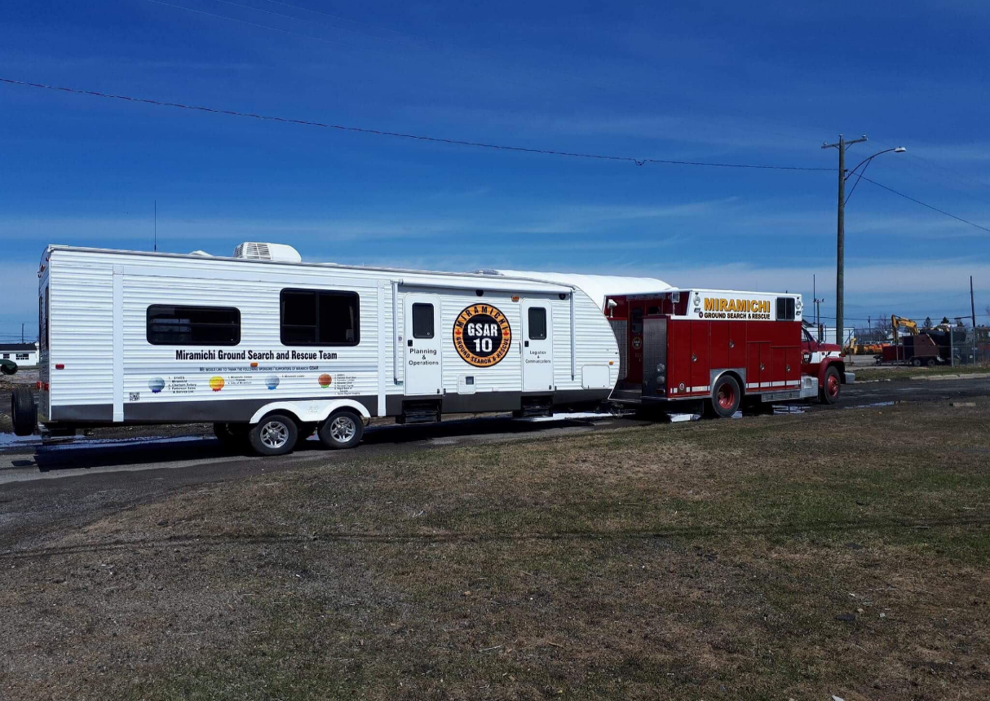
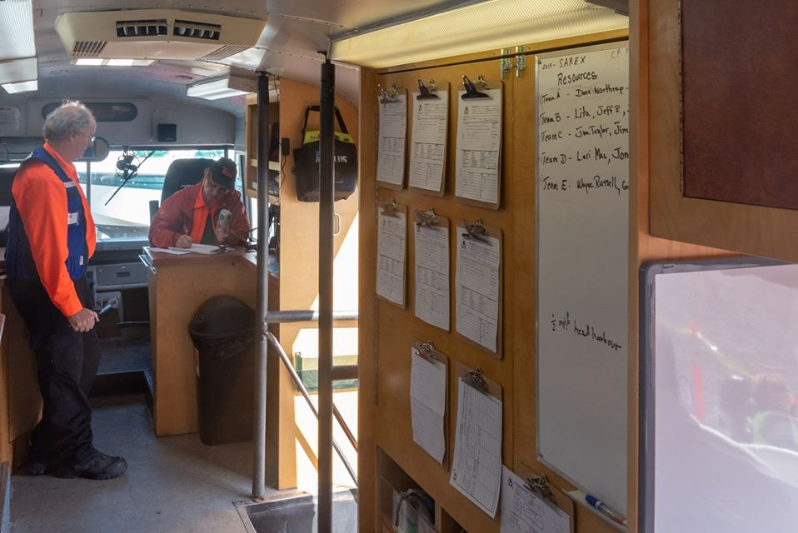
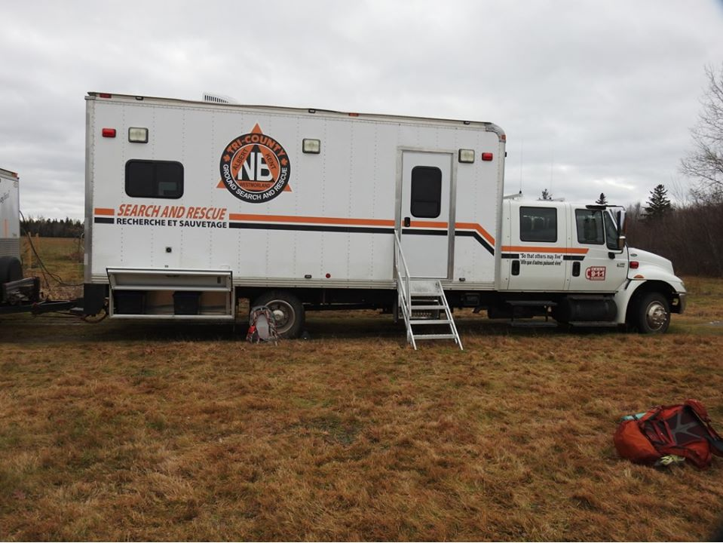
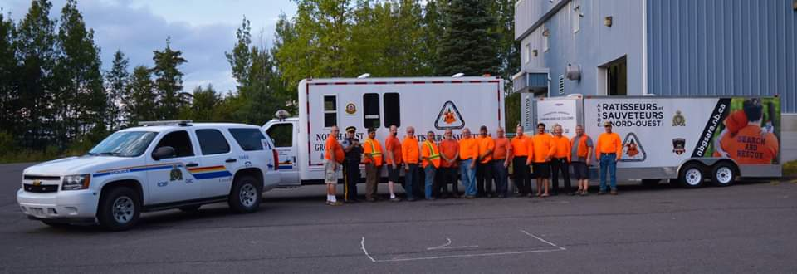
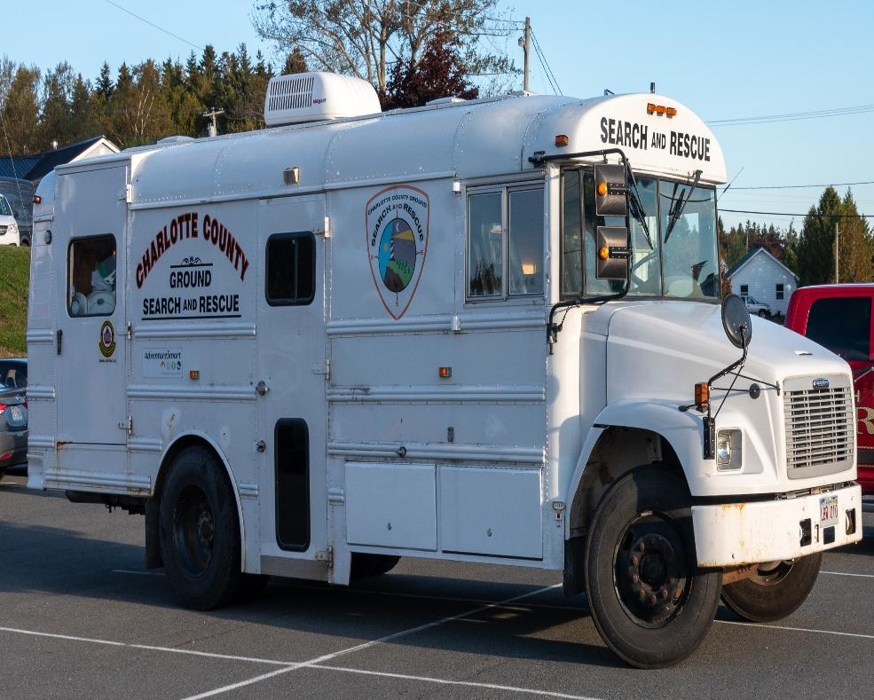
Where the decisions are made

Slide 13
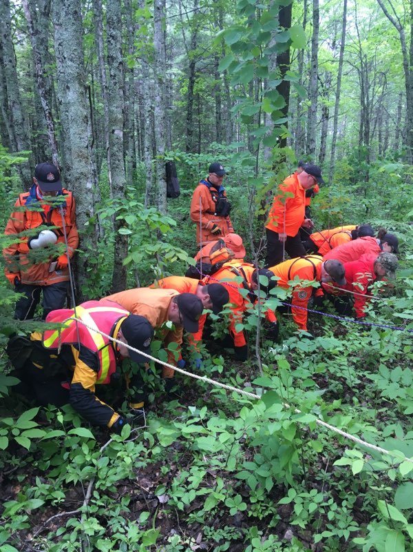
Evidence Search

Slide 14
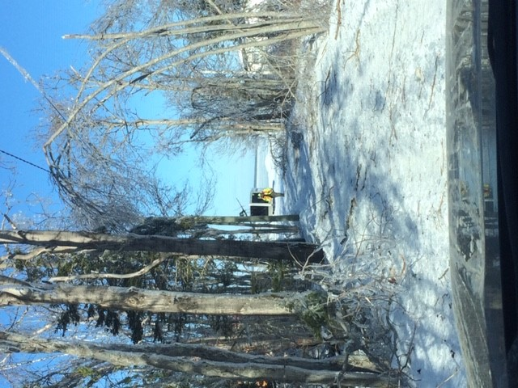
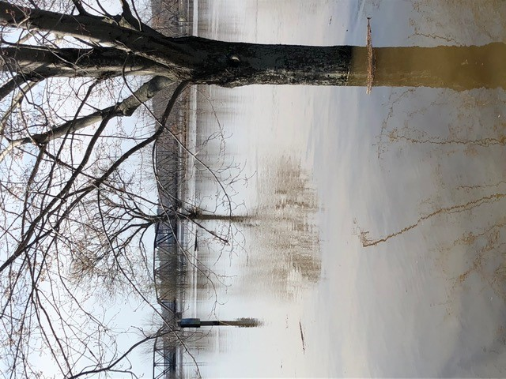
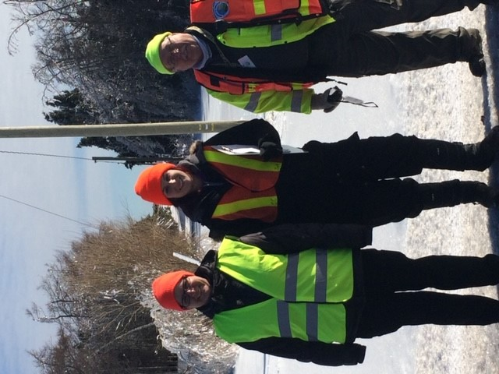
Non Traditional Roles

Slide 15
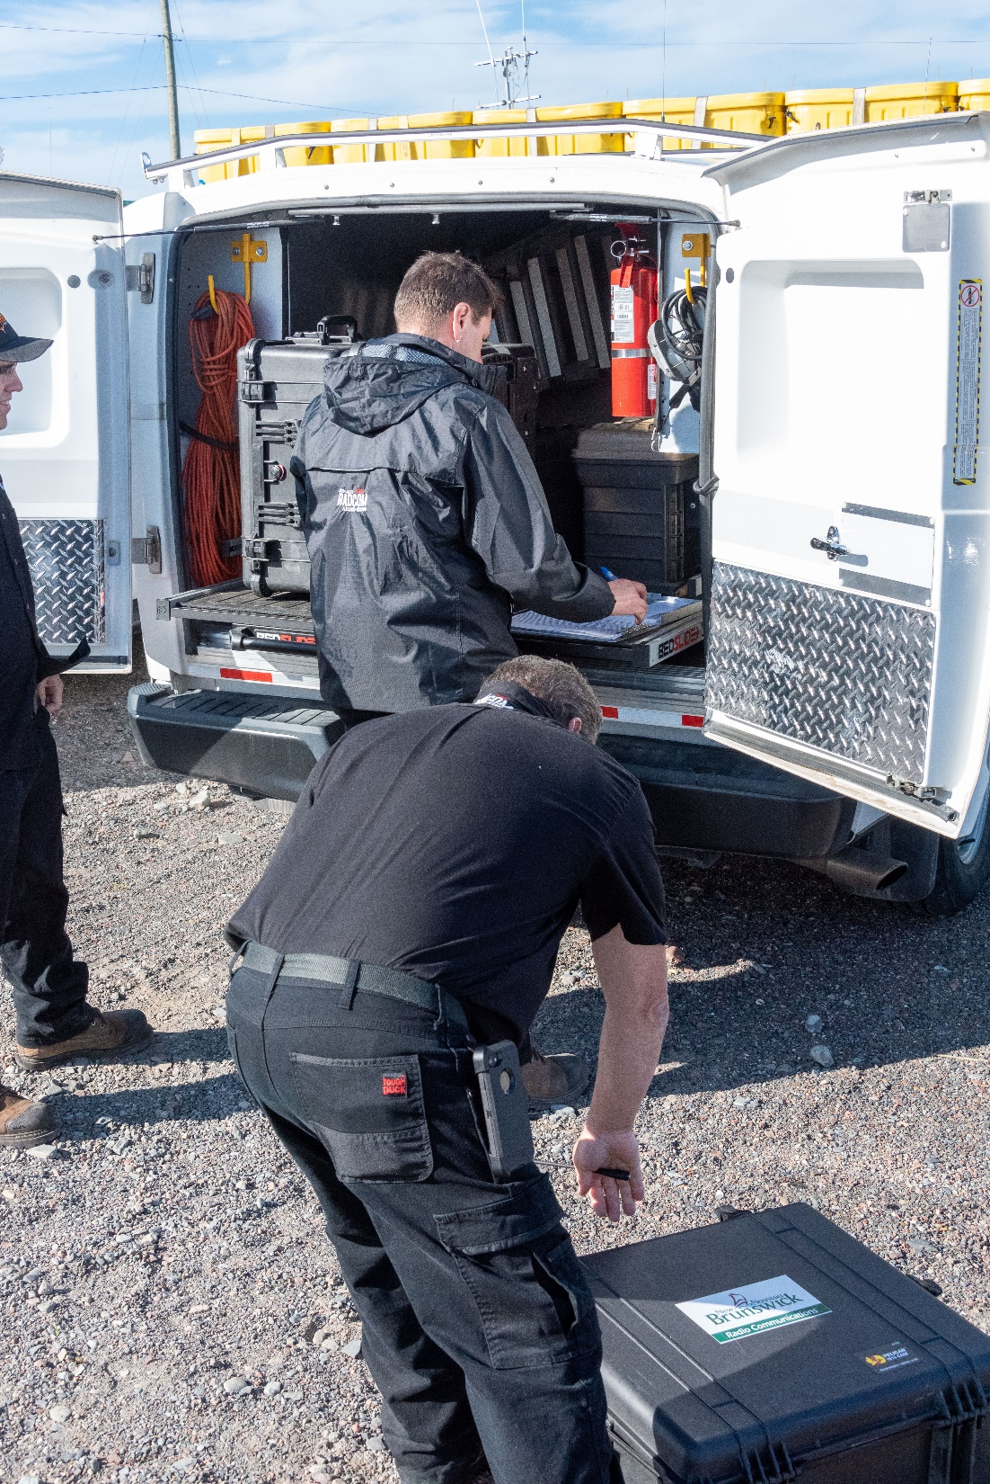
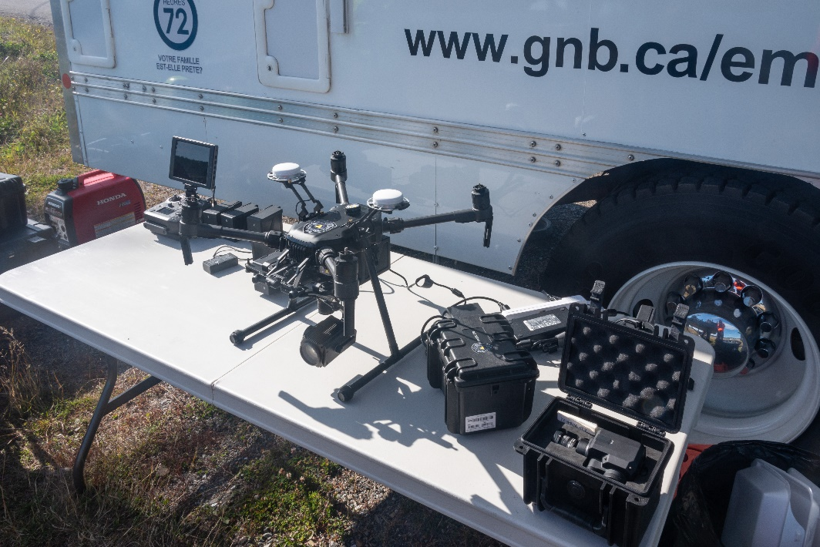
RPAS, providing eyes from above
RADCOMM, enhancing communications

Slide 16
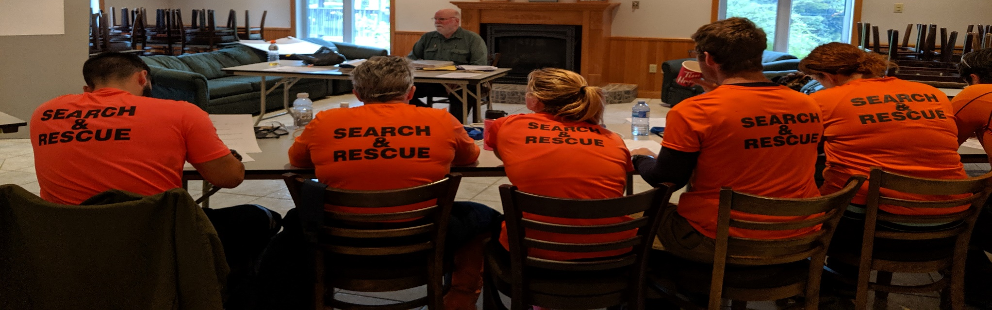
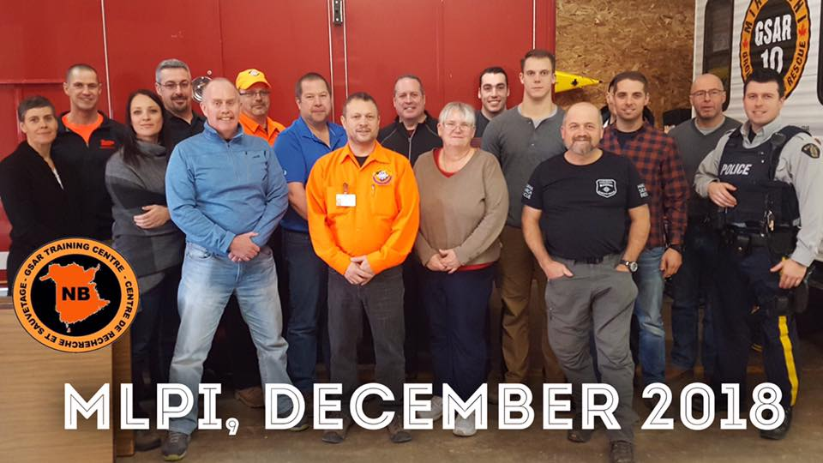
ICS Training New Search Managers

Slide 17
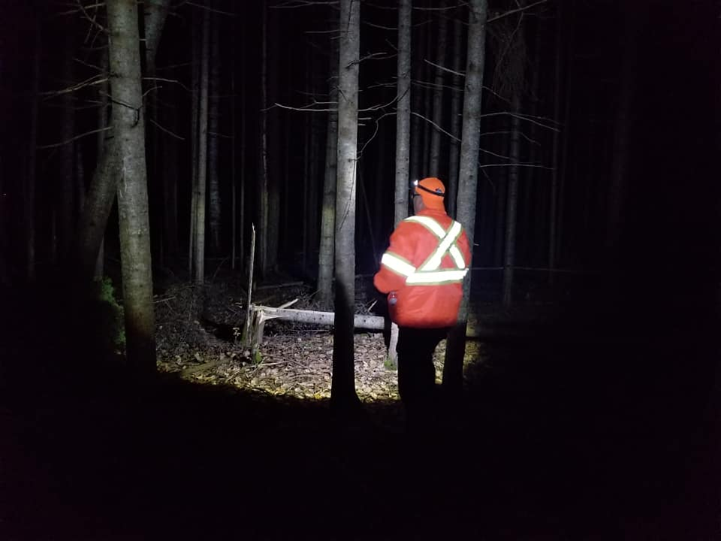
Questions ? Thank You – Merci

