Slide 1


Emergency Management Presentation
Sgt. Michel LITALIEN Cpl. Ryan LEWIS
Cst. Mike OLIVER Cst. Wil STAPLETON
« J » Division RCMP Operational Readiness & Response Unit

Slide 2

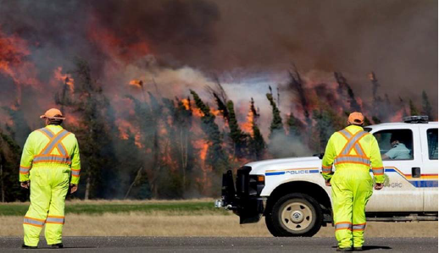
Advanced Warning
No Advanced Warning

Slide 3
EM Program
Emergency Management Program (EM)
Is responsible for creating a standardized framework that enables the RCMP to increase its capability and to mount emergency response operations to all-hazards emergencies and / or disasters through advanced planning.
The EM Program is comprised of the following components:
National Emergency Planning;
National Exercise Coordination;
National Business Continuity Planning (BCP) Policy;
Incident Management System;
Best Practices and Lessons Learned

Slide 4
RCMP ORR
Operational Readiness & Response (ORR) Division Level
ORR provides a central point of contact within the Division for emergency management and incident response across within the RCMP.
National Level
ORR has a central secretariat at HQ in Ottawa which works with those on the operational front across the country to provide a coordinated and timely response to any emergency.

Slide 6
CIP
Critical Incident Program (CIP)
CIP provides and maintains teams and resources to ensure RCMP readiness, response and management of critical incidents, emergencies and disasters by providing
Chemical Biological Radiological Nuclear Explosives (CBRNE)
Emergency Medical Response Teams (EMRT)
Emergency Response Team (ERT)
Negotiator (NEG)
Public Order Team (STO)
Remotely Piloted Aerial Systems (RPAS)

Slide 7
Police Force of Jurisdiction Response
Police Force of Jurisdiction (POJ) Response
Members are Dispatched to Scene
First Member to arrive established Command & Control (Incident Command).
Member provided situational awareness to Team Leader, OPS NCO or OCC Risk Manager.
If the scope of response required exceeds District Capacities, or requires Specialized Teams/Resources, the OCC Risk Manager will contact the On Call Critical Incident Commander (CIC), who has the authority to activate the CIP Package as required.
If CIP is activated, the CIC become the Incident Commander.

Slide 8
DEOC 24/7
Division Emergency Operations Centre (DEOC)
Coordinate and integrate preparedness and response activities within the Division required for the RCMP to protect the health, safety, security and economic well-being of all employees and residents during an impending (threating) event or an all-hazard civil emergencies.
These activities carry over to, and directly support the day-to-day police operations

Slide 9
NOC 24/7
RCMP National Operations Centre (NOC)
A fully secure and integrated command and control centre for centralized monitoring and co-ordination during critical incidents and major events. NOC is the principal contact point between the RCMP and key national and international partners during periods of crisis and emergencies. It is responsible for the continued functioning and enhancement of multi-departmental working groups involved in national security and counter-terrorist plans, and for the communication of time-sensitive tactical and strategic information and intelligence.
Key Responsibilities
The NOC operates 24/7/365 to monitor and coordinate the RCMP's official response to airborne incidents, major events, natural disasters, incidents involving national security, and other crisis that could affect the safety or well being of Canadians and/or our members.
It is an integral part of the Canadian government's emergency response plans, and acts as the principal contact point between the RCMP and its national and international crisis management partners.

Slide 10
GOC
Government of Canada Operations Centre (GOC)
The Government Operations Centre (GOC) provides an all-hazards integrated federal emergency response to events (potential or actual, natural or human-induced, accidental or intentional) of national interest. It provides 24/7 monitoring and reporting, national-level situational awareness, warning products and integrated risk assessments, as well as national-level planning and whole-of-government response management.
During periods of heightened response, the GOC is augmented by staff from other government departments/agencies (OGD) and non-governmental organizations (NGO) who physically work in the GOC and connect to it virtually.

Slide 11
Structure
- MEOC – Localized Event - REOC – Regional Event - PEOC – Provincial Event - DEOC – RCMP Divisional Event - NOC – RCMP National Event - GOC – Federal Event

Slide 12

PEOC & RCMP
LEVEL 1: ENHANCED MONITORING – DOES NOT REQUIRE RCMP ATTENDANCE, BUT MAY REQUIRE PARTICIPATION IN TELECONFERENCE.
A level 1 response is a continuous monitoring and reporting of an emerging situation or an emergency that does not require provincial control.

Slide 13
LEVEL 2: PARTIAL ACTIVATION - REQUIRES RCMP ATTENDANCE A level 2 response requires selected critical members of the PEOC to remain at the PEOC to assist in the management of the response. - The Member will contact the District that is impacted by the event. The Member will provide an explanation of our PEOC Liaison role and contact information. - The Member will request a Liaison contact from the District. - The Member will request the following be provided to the PEOC Liaison at designated timings (prior to PEOC briefings): - Health & Safety of our Members. - Situational Awareness and Primary Objectives. - Resources. - Wants/Needs.

Slide 14
LEVEL 3: FULL ACTIVATION
- A level 3 response is one that is sufficiently serious to require a ‘whole of government’ response, and requires all members of the PEAC to be actively engaged.
- The Member set priorities, assign tasks and coordinate operations for his/her respective department.
- The Member will undertake such planning as is necessary to coordinate future phases of the operation, such as evacuation or recovery.
- This may require two (2) members present.
- Events warranting ORR participation: Weather related events………

Slide 15
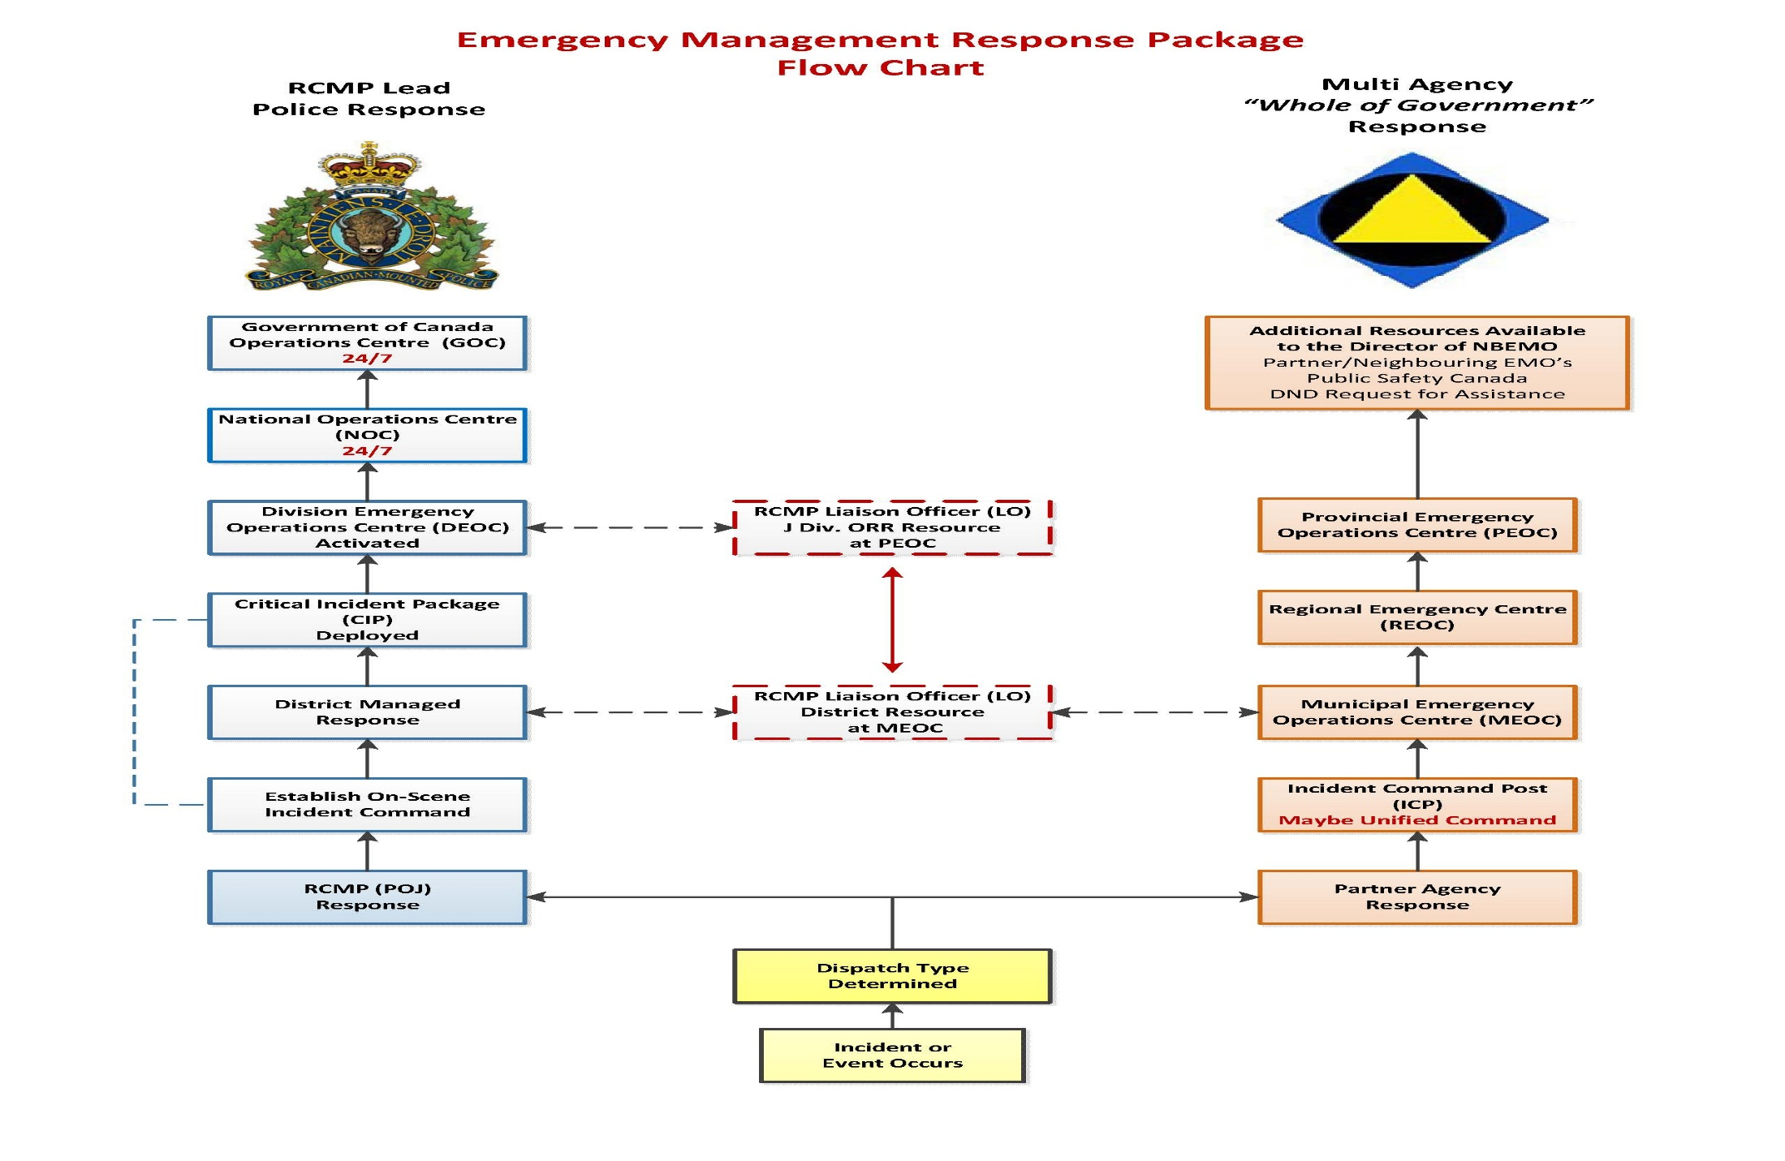
QUESTIONS?

Slide 16

GSAR & PDS
Police Dog Services (PDS) dispatched for all missing persons files
PDS liaise with the POJ & GSAR for coordinated efforts
PDS program coordinator conducts yearly evaluations of civilian search dog teams.

