Slide 1


New Brunswick Public Library Service
Strategic Plan, Year 2 2018-19
Summary Report
Connect
Learn. Read. Play. Create. Succeed.
Notes:
This provides an overview of some of the key accomplishments in 2018-19 from year 2 of the NBPLS Strategic Plan.

Slide 2
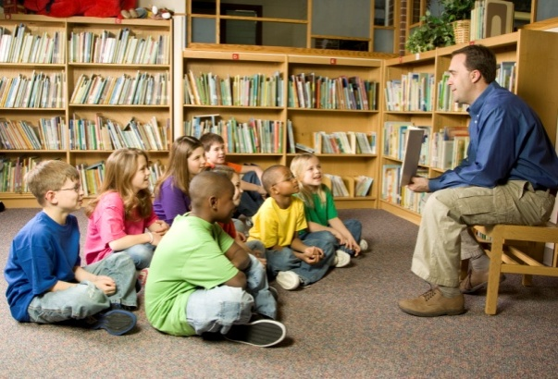
Goal 1 - Cultivate & Inspire Young Readers
Diverse & inclusive collections
Every Child Ready to Read
Afterschool programs
Interactive learning spaces
Notes:
NBPLS is investing in diverse and inclusive collections.
98% of libraries are delivering workshops in their communities on Every Child Ready to Read - an evidence based program for delivering children’s programs focused on the principles of singing, reading, writing, talking and playing. Libraries are giving workshops to parents/caregivers as well as community groups who provide services to children – e.g. daycares, family resource centres.
98% of libraries are promoting and delivering afterschool programs.
All libraries have implemented interactive learning spaces for children 0-5 years.

Slide 3

Goal 2 - Champion Literacy & Lifelong Learning
Common visual identity
Membership drives
Unserved groups
Adult digital technology skills
Self-led learning and research
Notes:
Libraries now have guidelines on using the NBPLS logo as well as the option to create and use their own local logo on promotional materials. This will have the benefit of increasing awareness of programs and services by using a common visual identity.
All libraries have carried out at least one local membership drive. Examples include targeted membership drives at farmers markets, with local businesses, senior homes, day cares and schools.
In an effort to reach an unserved population, the Mgr. W.J. Conway Public Library in Edmundston undertook a pilot project to offer book lending service to the detainees of the Madawaska Regional Correctional Centre (provincial institution) in Saint-Hilaire. 50% of the detainees residing at the correctional centre benefitted from the service with visits by library staff every three weeks. The pilot serves as a model for other interested libraries that are close to a provincial government correctional centre.
Libraries now have guidelines to help them generate ideas to offer adult digital technology skills programs. 97% of libraries have already developed ideas for future programs. What are digital technology skills? They include applying for a job online, using digital devices, or learning how to use library databases for research.
To support patrons’ self-led learning and research, all libraries are promoting NBPLS’ online databases available from the NBPLS website which provide access to Canadian magazines, newspapers, consumer health information, automotive guides, historical resources, encyclopaedias, and almanacs.

Slide 4

Goal 3 –
Contribute to Community Economic Growth
Employability
Business / entrepreneurship
Population growth
Official language learning
Financial literacy
Notes:
Key areas of focus for community and economic growth are supporting employability, business, newcomers, second language learning and financial literacy.
97% of libraries offered at least one program to support employability. Examples include: help with preparing for a job interview, filling out online applications, writing resumes, and information sessions about the Career Cruising database.
98% of libraries offered at least one program to support business and entrepreneurs. Examples include: how to do market research and how to write a business plan, networking events for small business owners, information sessions and events with high school entrepreneurship students, lunch and learn programs.
94% of libraries offered at least one program to support newcomers. Examples include: multilingual story times, open house events to invite newcomers to visit and tour the library, discussion groups aimed at newcomers meeting people in their community, outreach and presentations to multicultural associations.
95% of libraries offered at least one program related to financial literacy. Examples include working with partners to offer workshops for children, teens, adults and seniors on learning about how to manage money, information sessions on fraud prevention, online banking, retirement and investing.
All libraries have been exploring community partners or offering programs to promote the use of two official languages. Examples include: conversation circles, bilingual story times, film series in both official languages, offering bilingual STEAM programs.
All libraries promoted Rosetta Stone, a free online language learning resource.
All libraries promoted collections relating to business / entrepreneurship, financial literacy.

Slide 5

Goal 4 –
Stimulate Imagination & Creativity
Spaces & resources for creating & learning
STEAM programs
Object lending & pass lending
Galleries, libraries, archives and museums
NB culture and heritage
Intergenerational programs
Notes:
97% of libraries revised their facility improvement plans to include space and resources for creating and learning for all ages. These flexible spaces and resources will be added as local budgets permit. Examples include: equipment and technology for a dedicated or mobile makerspace, skill kits (e.g. knitting, canning, preserving, exploring nature, bicycle repair).
98% of libraries offered at least three STEAM based programs (science, technology, engineering, arts, math) in collaboration with community partners and with the use of regional STEAM kits. Libraries across the province partnered with Science East to offer coding programs for children.
All libraries explored ideas or started piloting a new alternative collection for loan based on community interests and needs. Examples include: musical instruments, board games, sports equipment, hand tools, seeds, baking utensils.
NBPLS partnered with NB organizations to lend free cultural and heritage passes with a public library card. Provincial partners included: Village historique acadien, NB Museum, Antique Automobile Museum, Kings Landing, the Beaverbrook Art Gallery and Musée acadien. Over 1,600 new library cards were issued and almost 4,000 passes were redeemed.
Locally, libraries also explored ideas to lend local or regional passes. Some examples in various regions include: skating and ski passes, kayak/canoe rental passes, exercise class passes, theatre passes, beach passes, local museums.
NBPLS opened the NB Library of Craft and Design in Fredericton in partnership with the NB College of Craft and Design. It is a public-academic library, the first of its kind in the country, that serves both students of the college, the general public and the arts community in New Brunswick.
NBPLS continued to offer collections, exhibitions and programs that feature local creators (artists, musicians, authors, filmmakers) and local history.
NBPLS continues to invest in NB materials as part of collections development.
All libraries offered displays of NB materials to promote NB culture and heritage to the public.
All libraries offered the Read Local campaign during Canadian Library Month. To support readers, patrons and staff were able to browse the New Brunswick collection room in the online catalogue as well as the New Brunswick Author Portal. Libraries hosted author visits and book clubs, did pubic service announcements and social media posts to promote reading NB authors and publishers.
97% of libraries have planned an intergenerational program or offered one. Examples include: book clubs, grandparents day story time, nursing home reading program, technology ‘petting zoo’, retro technology programs, reading buddies, games, and cursive writing programs.

Slide 6

Goal 5 –
Strengthen Community Connections & Access
Truth & Reconciliation Commission Calls to Action
Borrowing the Internet
Library open hours
Library Services by Mail
Library facilities
Broadband speed
Notes:
Libraries are engaged in developing and delivering programs that support the Truth and Reconciliation Commission’s calls to action, with 98% of libraries having carried out at least 3 Indigenous-themed programs in the last year. Examples include: Indigenous author book launches, story times, film screenings, and guest speakers to share Indigenous cultures and histories. NBPLS also released its new 3 year strategic plan for Indigenous library services with a focus on continuing to develop library collections, programs and spaces to reflect local Indigenous peoples.
NBPLS secured a funding partner to launch a 3 year pilot to borrow the Internet to help bridge the digital divide between those who can access the Internet at home, and those who cannot. The pilot launched in the Chaleur library region in Spring 2019 with funding from the Port of Belledune. The Wi-Fi hotspot lending service is the first of its kind to be offered in Atlantic Canada.
The 5 resource centres (Fredericton, Saint John, Moncton, Campbellton and Edmundston) continued to be open 7 days a week as part of a GNB pilot project. The pilot will continue for a fourth year.
NBPLS prepared a new 3 year action plan for Library Services by Mail with activities to reach new users. NBPLS released a brochure for library staff to promote LSBM during their outreach events.
Libraries continue to prepare budget proposals and grant applications to make facility improvements based on provincial library standards in partnership with their municipalities and school districts (in the case of public-school libraries).
Libraries continue to upgrade their Internet service to improve access for the public when options are available from commercial Internet providers.

Slide 7

Goal 6 –
Build on our Organizational Capacity to Provide Excellent Service
Impact of public library programs and services
Staff training
Collections development & management
GNB continuous improvement initiatives
Notes:
To help us build more evidence based data about our programs and services, NBPLS carried out a pilot to assess the outcomes of the Summer Reading Club in 2018 using a free tool developed for public libraries called Project Outcome (produced by the Public Library Association, a division of the American Library Association, with funding support from the Bill and Melinda Gates Foundation). It provides simple standardized surveys and data analysis tools to measure outcomes (impacts) of library programs.
Three libraries within the York Library Region participated in the pilot:
Fredericton Public Library (public library in an urban setting, serving a primarily Anglophone community)
Harvey Community Library (public-school library in a rural setting, serving a primarily Anglophone community)
Médiathèque Père-Louis-Lamontagne (Miramichi) (a public-school library in an urban setting, serving a Francophone community)
The Project Outcome pilot project in 2018 demonstrated that the NBPLS SRC does positively impact children’s reading behaviors as reported by their parents/guardians. Satisfaction with the program is very high, and comparable to the national level. As a result of the NBPLS SRC program, parents/caregivers reported that their children are maintaining or increasing their reading skills; are more confident readers; read more often; and use the library more often.
NBPLS also partnered with the NB Institute of Research, Data and Training to assess usage trends between 2010-2018 within NB public libraries. Their study concluded a remarkable stability and growth in the use of libraries, despite an aging population, economic stagnation, slow population growth, technological and social changes. Library use has been increasing overall. NB-IRDT concluded it was likely due to policy decisions and innovations regarding library access and services: more flexible ways of providing library cards (e.g. guest cards, limited borrowing cards), eliminating overdue fees for children and opening all public libraries on Saturdays and some on Sundays.
NBPLS continues to train staff on STEAM – Science, Technology, Engineering, Art and Math. All staff completed training on NBPLS online databases.
To support collections development and management, all regions implemented an automated tool to better manage the donation of books from the public.
NBPLS also implemented Resource Description and Access, the new international library standard for describing and accessing collections in the online catalogue. This included training library staff.
NBPLS is supporting GNB continuous improvement initiatives. Examples include: library staff being trained to do waste walks to look for efficiencies in how we do things; provincial office exploring new research projects with NB Institute of Research, Data, Training that will help us better understand outcomes from our programs and services; each region training library staff on records management practices and implementing file plans.

Slide 8

Provincial Outcomes
25% increase in Library Services by Mail circulation
Stable circulation of children’s materials
Stable circulation of NB materials
Stable circulation province-wide
Notes:
Based on the NBPLS three year strategic plan, several provincial outcomes were identified. The provincial outcomes are general indicators for NBPLS as an organization. The outcomes help us identify areas for growth.
2018-2019 data is compared to the baseline data from 2016-2017 to determine an increase or decrease.

Slide 9
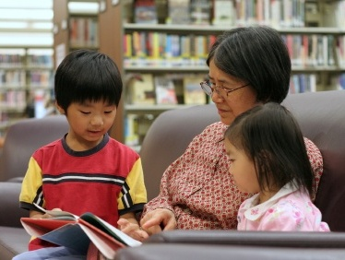
Provincial Outcomes
98% of libraries offered a minimum of 3 Indigenous-themed programs
98% of libraries offered a minimum of 3 STEAM based programs
100% libraries have a dedicated interactive learning space for families
5% decrease in children & teen program participants
12% decrease in adult program participants

Slide 10
Provincial Outcomes
32% increase in visits to online databases made available on the NBPLS website
8% increase in patron visits
6% increase in library memberships

Slide 11
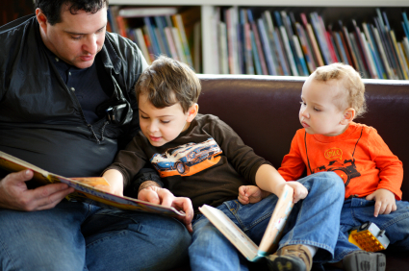


Connect.
Learn.
Read.
Play.
Create.
Succeed.

