Slide 1


New Brunswick Public Library Service
Strategic Plan, Year 1 2017-18
Summary Report
Connect
Learn. Read. Play. Create. Succeed.
Notes:
This provides an overview of some of the key accomplishments in 2017-18 from year 1 of the NBPLS Strategic Plan.

Slide 2

  Goal 1 - Cultivate & Inspire Young Readers
Every Child Ready to Read
Afterschool programs
Interactive learning spaces
Notes:
95% (59 of 62) of libraries have begun delivering workshops in their communities on Every Child Ready to Read - an evidence based program for delivering children’s programs focused on the principles of singing, reading, writing, talking and playing. Libraries are giving workshops to parents/caregivers as well as community groups who provide services to children – e.g. daycares, family resource centres.
All libraries are promoting and delivering content for afterschool programs.
98% of libraries have begun implementing interactive learning spaces for children 0-5 years.

Slide 3

  Goal 2 - Champion Literacy & Lifelong Learning
Membership drives
Self-led learning and research
Notes:
In year 1 of our strategic plan, a key activity under Goal 2 was membership drives. 97% of libraries across the system carried out at least one local membership drive.
At provincial office, two membership drives were held – one within our department (PETL) and another within GNB. The GNB membership drive occurred during Canadian Library Month.
Library Services by Mail also held a membership drive.
A promotional postcard was created as part of a mail-out campaign to encourage rural New Brunswickers who are unable to visit a library to sign up for LSBM. The mail-out was launched in spring 2017 via Canada Post’s SnapAdmail service.
LSBM is for New Brunswickers who cannot access a public library for a variety of reasons, including: living in a rural area, living with a disability or illness (including print disabilities), seasonal limitations (harsh winter), lack of personal transportation, temporary library closures, etc.
17,954 households received the LSBM postcard.
Since the membership drive, LSBM has received great feedback from the rural community, as well as from library staff from all over the province. Creating more visibility for a service that has never received any formal publicity was beneficial. This mail-out campaign followed a provincial all-staff training that raised awareness about the vulnerable sectors and how they could benefit from using LSBM.
Regions reported a hike in online registrations from the public to get a library card, and new people walking into their local libraries.
LSBM circulation increased 24% this year. New cards issued in 2017-18: 106.
To support patrons’ self-led learning and research, library staff have started receiving training on NBPLS’ online databases which are available through the NBPLS website. The training consists of five training sessions. Each presentation focuses on a group of similar databases, such as those which provide access to newspapers, historical resources or resources aimed at children & young adults. The training is delivered by webinar by members of the Reference Services team and regional office in each region. As each training module is delivered, staff are provided with tools to help promote the resources to the public.

Slide 4

  Goal 3 –
  Contribute to Community Economic Growth
Employability
Business / entrepreneurship
Population growth
Official language learning
Financial literacy
Notes:
Key areas of focus for community and economic growth are supporting employability, business, newcomers, second language learning and financial literacy.
This year saw libraries explore community partners to assist with program development and delivery in these areas.
All libraries promoted Rosetta Stone, a free online language learning resource.
All libraries promoted collections relating to business / entrepreneurship.
NBPLS invested in developing the financial literacy collection, and a Financial Literacy room was created in the online catalogue.

Slide 5
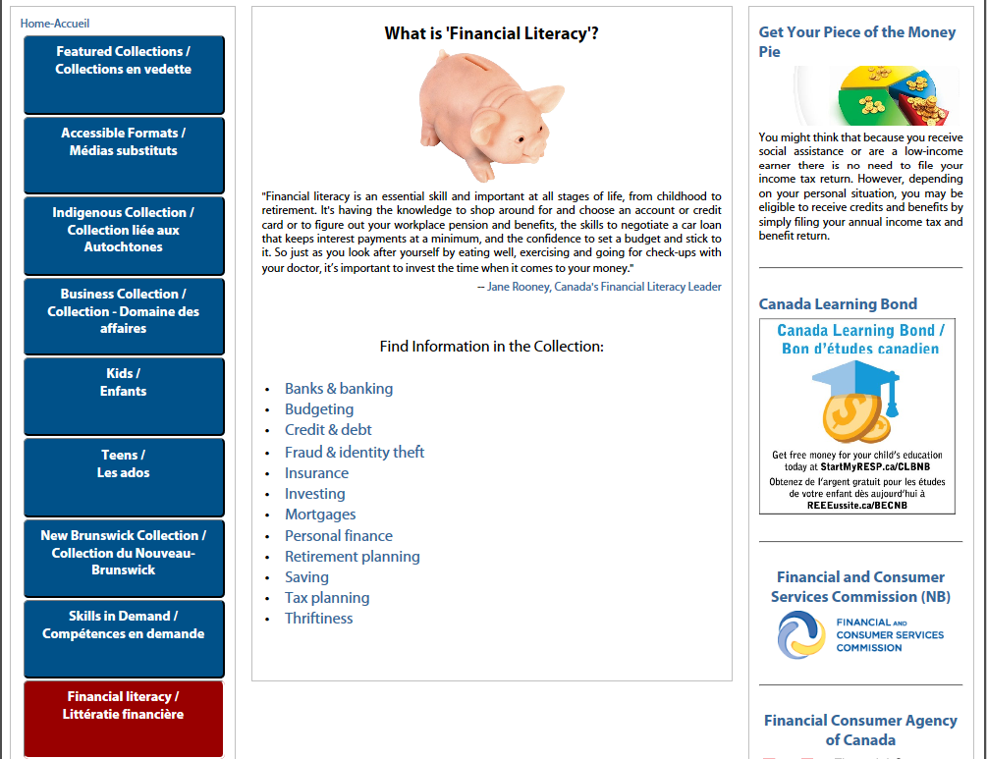
Financial Literacy Room in Catalogue
Notes:
The Financial Literacy room can be accessed by navigating to the NBPLS online catalogue and clicking on the “Financial Literacy” box in the left hand menu.

Slide 6

  Goal 4 –
  Stimulate Imagination & Creativity
Promote NB culture and heritage
Collaborate with galleries, libraries, archives and museums
Notes:
NBPLS continued to offer collections, exhibitions and programs that feature local creators (artists, musicians, authors, filmmakers) and local history. NBPLS continues to invest in NB materials as part of collections development.
All libraries offered displays of NB materials to promote NB culture and heritage to the public.
NBPLS partnered with NB organizations to lend free cultural and heritage passes with a public library card.
NBPLS has completed a feasibility study and is currently working with the NB College of Craft and Design to establish a public-academic library - the first of its kind in the country.

Slide 7

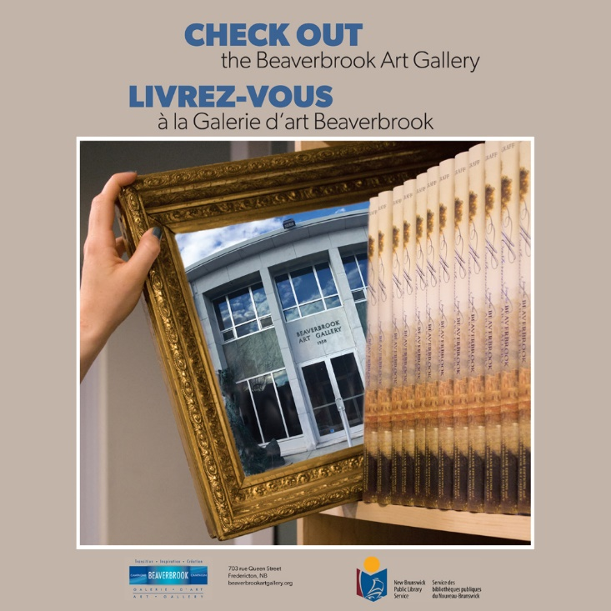
Pass Lending
Notes:
Our provincial pass lending projects are very popular with patrons. Guidelines were released this year to help Library Managers and Directors establish smaller pass lending initiatives with local institutions.
NBPLS is responsible for the logistics of lending the passes and for promoting the partnership. Partners are responsible for graphic design of the promotional materials.

Slide 8
Pass Lending Statistics
Partner | Passes Loaned | Passes Redeemed | Redemption Rate | New Cards
VHA | 4,463 | 1,177 | 26% | 821
NBM | 1,645 | 228 | 14% | 161
Kings Landing | 4,825 | 3,144 | 65% | 1,147
BAG | 1,260 | 264 | 21% | 81
Total | 12,193 | 4,813 | 39% | 2,210
Notes:
Village historique: Passes were loaned during the Semaine de la fierté français (March 19-25, 2017) and could be redeemed from June 11 – September 30, 2017.
New Brunswick Museum: Passes were loaned during the month of May and could be redeemed from May 1, 2017 – January 7, 2018. A “Celebration Tour” accompanied the campaign. NBM staff visited libraries around the province to talk about the museum and its artefacts and to encourage people to check out passes.
Kings Landing: Passes were loaned during the month of September and could be redeemed from September 1 – 30, 2017.
Beaverbrook Art Gallery: Passes were loaned during Canadian Library Month (October) and could be redeemed from November 1, 2017 – March 31, 2018.

Slide 9

  Goal 5 –
  Strengthen Community Connections & Access
Support Truth & Reconciliation Commission Calls to Action
Explore borrowing the Internet
Explore expanding open hours
Promote Library Services by Mail
Improve library facilities
Improve broadband speed
Notes:
Libraries are engaged in developing and delivering programs that support the Truth and Reconciliation Commission’s calls to action, with 98% of libraries having carried out at least 3 Indigenous-themed programs in the last year.
NBPLS has explored a funding partner to pilot borrowing the Internet to help bridge the digital divide between those who can access the Internet at home, and those who cannot.
The 5 resource centres (Fredericton, Saint John, Moncton, Campbellton and Edmundston) continued to be open 7 days a week as part of a GNB pilot project. The pilot will continue for a third year.
As noted earlier, Library Services by Mail held a membership drive by mail. LSBM also promoted its services to NB health networks by connecting with discharge nurses to support people recovering from an illness or with a disability.
Libraries continue to prepare budget proposals and grant applications to make facility improvements based on provincial library standards in partnership with their municipalities and school districts (in the case of public-school libraries).
23 libraries in the province were able to upgrade their Internet service to improve access for the public.

Slide 10

  Goal 6 –
  Build on our Organizational Capacity to Provide Excellent Service
Develop plan for community-led libraries
Train staff on emerging technologies
Implement GNB continuous improvement initiatives
Notes:
The provincial office has prepared a working draft of a plan to train staff on the community-led libraries approach. This training plan will be completed in 2018-19 and the training delivered to staff in Year 3. Community-led libraries is an approach to program and service planning that focuses on building relationships with community members to remove barriers to using libraries.
NBPLS continues to train staff on emerging technologies. This year’s focus was on STEAM – Science, Technology, Engineering, Art and Math. Further training will continue in Year 2
The provincial office has coordinated the implementation of GNB continuous improvement initiatives. This includes doing waste walks to look for efficiencies in how we do things and scoping research projects that will help us better understand outcomes from our programs and services.

Slide 11

  Provincial Outcomes
2.5% increase in library memberships
1% increase in children’s circulation
4% increase in circulation of NB materials
Stable overall circulation of the provincial collection

Slide 12
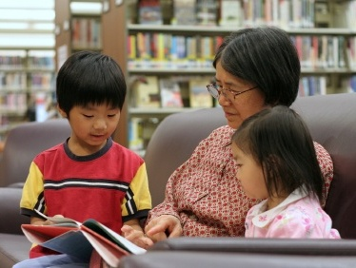
  Provincial Outcomes
98% of libraries offered a minimum of 3 Indigenous-themed programs
24% increase in Library Services by Mail circulation
90% libraries have a dedicated interactive learning space for families

Slide 13
  Provincial Outcomes
9% increase in visits to online databases made available on the NBPLS website
3% increase in patron visits

Slide 14



Connect.
Learn.
Read.
Play.
Create.
Succeed.

